Slide 1
Global Population Basics
Rural sustainability seminar
Becky Bender, Ellen Brenna, Selene Gonzalez, Andrew Orthober, Hannah Smith

Slide 2
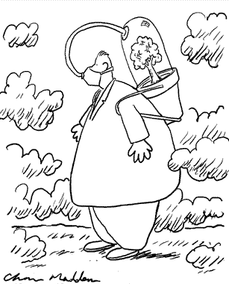
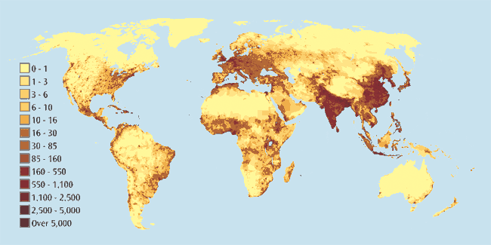
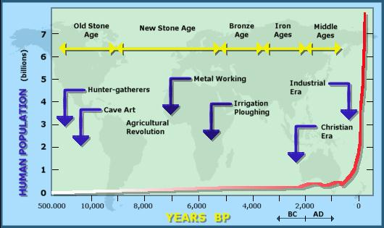
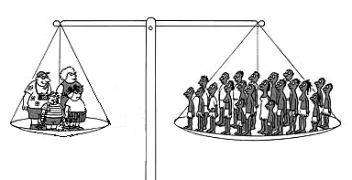
Current Population Dynamics
Who? How many? Where?
http://local.brookings.k12.sd.us/biology/HumanImpact.htm

Slide 3
Fertility & Birth Rates
Fertility rates
Average number of children per woman
Birth rates
High birth and fluctuating death rates
Declining birth and death rates
Approaching replacement fertility
Low birth and death rates
Replacement
Women have just enough female babies to replace themselves

Slide 4
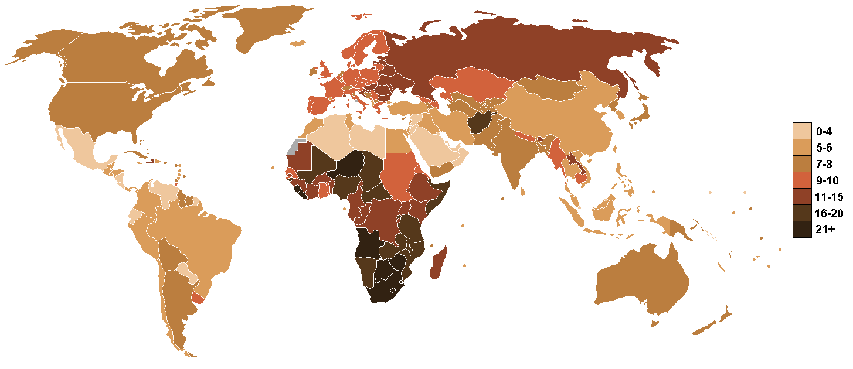
Mortality
Number of deaths (per 1000 people per year)
During ancient times: 40 per 1000 per year
Hygiene, sanitation, modern medicine & antibiotics have reduced mortality rate greatly
http://en.wikipedia.org/wiki/File:Death_rate_world_map.PNG

Slide 5
Carrying Capacity
Resource limitations and space limit populations naturally on Earth
Do the same rules apply to humans?
Yes, projections show carrying capacity being reached at between 10 and 20 billion people
No, we innovate new technologies to increase the efficiency of resource use
With current and projected growth this is an important issue

Slide 6
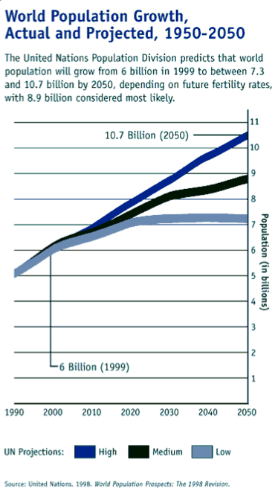
Population Projections
Low fertility rates in developed countries
Declining fertility rates in some developing countries
Little change in fertility rates in some developing countries
Future world population growth will depend on multiple factors

Slide 7
Discussion Questions
What has played the greatest role in decreasing mortality rates around the world? What else do you think can be done?
Do you humans have a carrying capacity? Will we ever reach it?
Do you think population growth needs to be limited? What do you think are effective ways to control growth?

