Slide 1
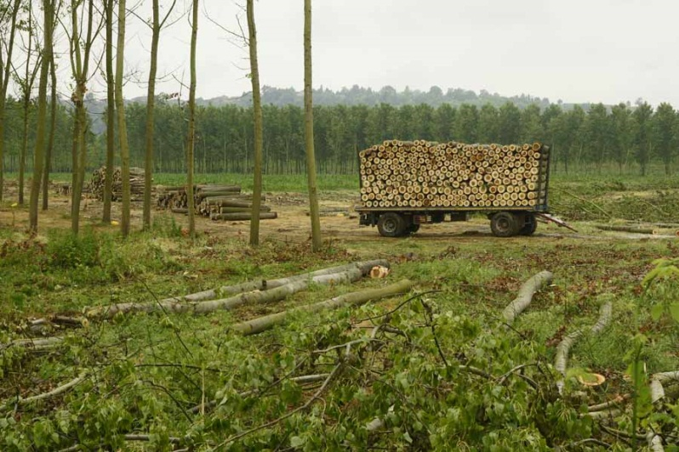
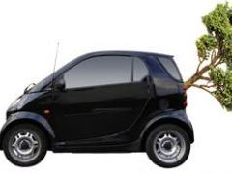
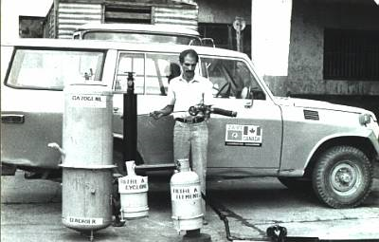
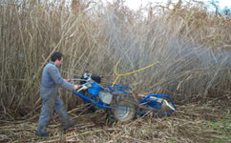
Alternative Energy Forest Products and Residues
http://www.bionomicfuel.com/how-does-cellulosic
-ethanol-production-work/
http://www.panoramio.com/photo/44421156
What do we have?
How can we use it?
http://www.smartinnova.com/index.php?p=re-gasify
http://planetearth.nerc.ac.uk/news/story.aspx?id=361

Slide 2
Harvesting for Cellulosic Residues (La cosecha de los biocombustibles celulósicos)
Pros
Cons
Doesn’t require diverting the use of cropland
Can be made from non food plants
Creates jobs for the harvesters and those building the plant and working in it
Renewable (if done correctly)
Transportation of harvest
Possible mass-farming and clear-cutting
Harvesting would have to occur before pay-off
Some farmers will need to have set-aside land
As difficult as encouraging recycling

Slide 3
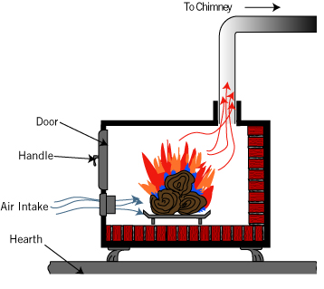
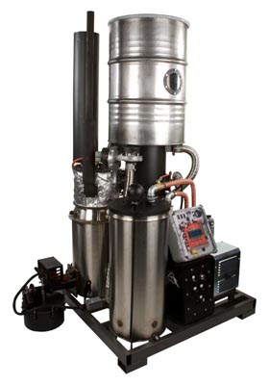
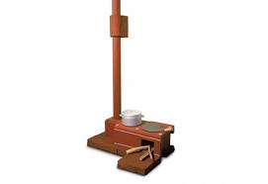
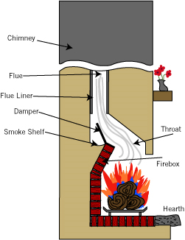
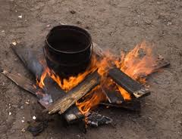
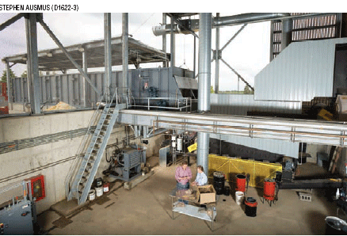
Biomass and Burning
Old ideas
New perspective

Slide 4
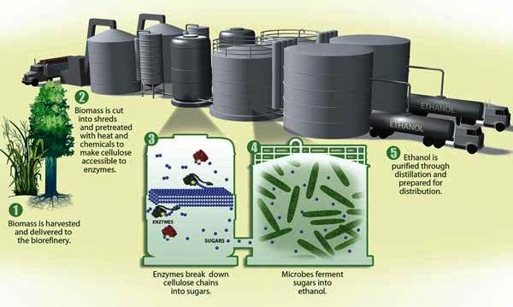
Cellulosic ethanol
What is it? Is a renewable energy resource used as transportation fuel as one of the alternatives to petroleum from the cellulose in plant biomass (Kumar and Murthy,2011).
How is cellulosic ethanol made?
What is the cellulosic ethanol made from?
Materials such as:
Wood
Grasses
Wastes
Is cellulosic ethanol a good Idea?
The answer could be No, but also Yes.
No :
-High deforestation
-Further expansion of monoculture tree plantations
Yes:
-Operation in small-scale - The main raw materials used could be waste - Based on locally available resources
Source: http://ethanol.yolasite.com/process.php

Slide 5
Sources
http://money.cnn.com/galleries/2008/fortune/0804/gallery.green_biofuels.fortune/4.html
http://money.usnews.com/money/personal-finance/articles/2008/01/11/cellulosic-ethanol
http://www.rurdev.usda.gov/rbs/pub/jan09/opportunities.htm
http://www.huffingtonpost.com/2008/11/21/cellulosic-ethanol-what-i_n_145538.html
ADAS Consulting Ltd. 2003. Renewable Energy and Its Impact on Rural Development and Sustainability in the UK, ADAS Consulting Ltd., University of Newcastle, UK, 68 pp.
http://www.michigan.gov/documents/wood_energy_in_michigan--final1_169999_7.pdf
http://livingwithmyhome.com/201-home-tips/pillar-to-post-fireplace-wood-stove.aspx
http://www.design.philips.com/about/design/designnews/newvaluebydesign/helping400million_people_give_up_smoking.page
http://gekgasifier.com/
http://www.thebioenergysite.com/articles/435/growing-biofuel-crops-sustainably

