Slide 1
Hydroelectric Power
Jason Clark

Slide 2
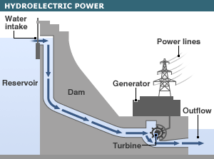
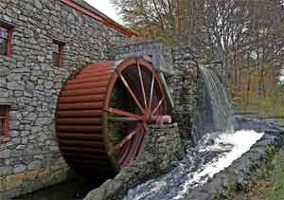
Concept
Use the gravitational force of falling or flowing water to turn a turbine, which produces energy.
Hydroelectric power is the oldest form of power, first seen in ancient times to grind flower and other tasks.
The 19th century gave birth to the first modern hydroelectric power, with the creation the electrical generator.

Slide 3
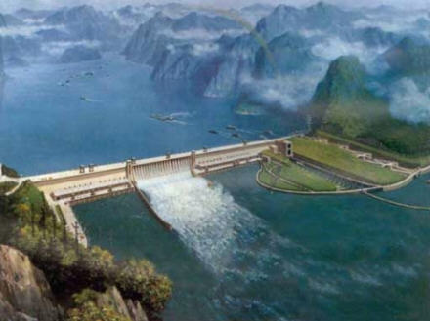
Hydroelectricity and the world
Hydroelectricity accounts for 20 percent of the worlds electricity
The most used renewable form of energy, accounting for close to 85 percent of renewable energy.
Many rural communities in developing countries are without power.
Renewable energy technology can greatly impact rural communities.

Slide 4
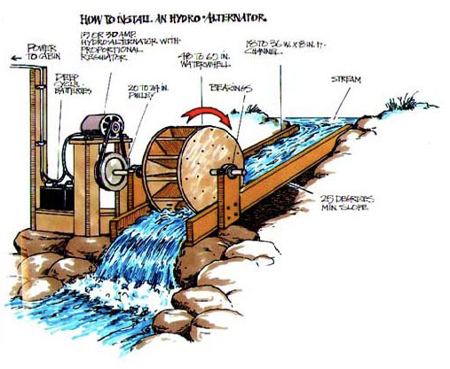
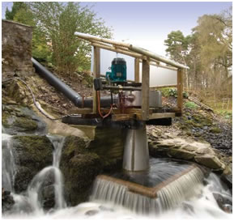
Developing Countries
Developing countries often have insufficient power grids or area’s where power does not reach
Hydroelectricity can provide these rural remote areas with stable power for low costs.
Hydroelectric power is the future of rural developing areas

Slide 5
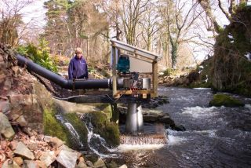
China
With a rapidly growing population, china has been utilizing hydroelectricity to provide energy.
Many of china’s population live in rural areas where hydro lines don’t reach.
Small scale hydroelectric power plants are easy to build and can provide stable power for local communities with minimum ecological impact
China is a leader in hydroelectric power technology and well as other renewable energy
The Three Gorges Damn (completed in 2006) in China, is the largest power generation facility in the world.
Built to help with the growing population the damn spans across Yangtze River

Slide 6
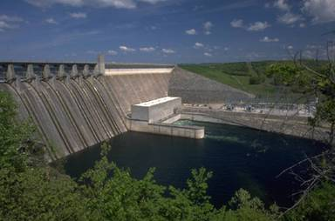
Advantages
Cost; the cost of running and maintaining a hydroelectric facility are much lower than that of a fossil fuels.
Can provide energy where the central grid can't reach (rural communities)
Increase water depths for shipping (Three Gorges Dam)
Provide economic stability to local communities
Environmentally friendly
Create reservoirs for fish habitat, recreation and ecosystems (also Disadvantage)

Slide 7
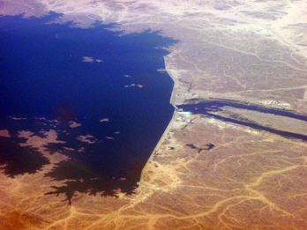
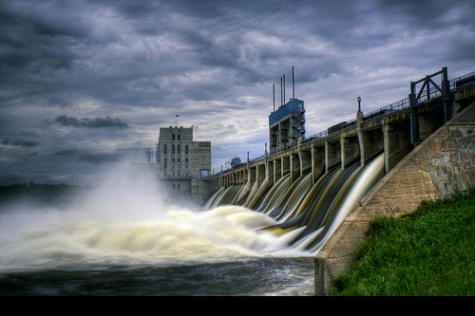
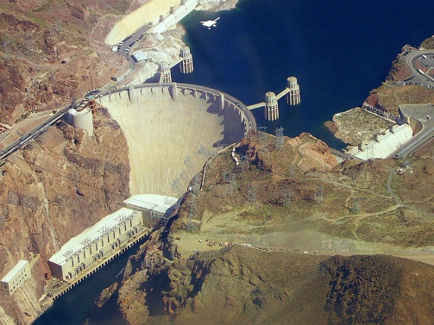
Disadvantages
Destructive to aquatic ecosystems
Prevent access of fish to breeding grounds
Disturb plant life above and below water
Destructive to terrestrial ecosystems
Destroys animal and plant habitat
Need flowing water supply

Slide 8
Future
Renewable energy technologies are constantly being developed with pressure of climate change the need for hydroelectric power and other renewable resources are high
With the growing concern of global warming, developed countries are also starting to better utilize hydro power and other renewable resources
Hydroelectric power is a cheap and affordable way for developing counties to generate power

Slide 9
Work Cited
ADAS Consulting Ltd. 2003. Renewable Energy and Its Impact on Rural Development and Sustainability in the UK, ADAS Consulting Ltd., University of Newcastle, UK, 68 pp.
Zhou, A. and Byrne, J. 2002. Renewable Energy for Rural Sustainability: Lessons from China, Bulletin of Science Technology & Society, 22: 123.
Alazraque-Cherni, J. 2008. “Renewable Energy for Rural Sustainability in Developing Countries,” Bulletin of Science Technology & Society, 28: 105.
O’Neill-Carrillo E., Ortiz-García, C., Pérez, M., Baiges, I, Minos S., 2009. “Experiences with Stakeholder Engagement in Transitioning to an Increased Use of Renewable Energy Systems,” Paper presented at the IEEE Conference in Atlanta, Georgia (March, 2009).

