Slide 1
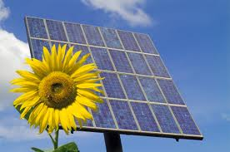
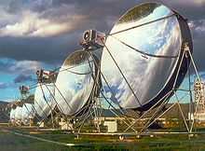
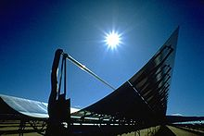
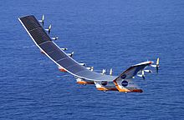
Solar Energy
Universidad de Sonora

Slide 2
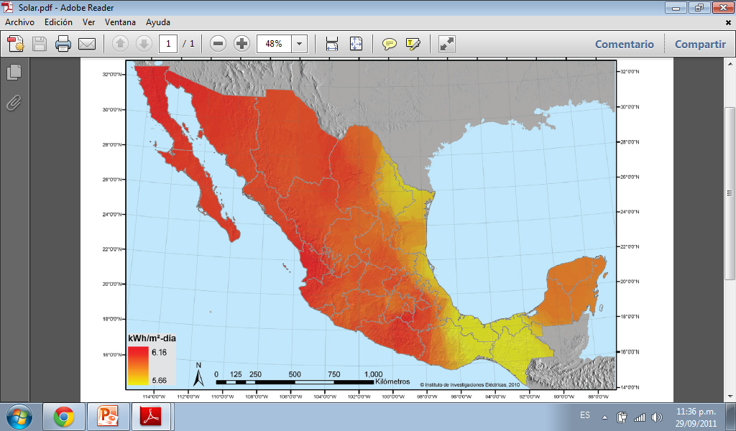
SOLAR ATLAS OF MEXICO
It was until 2007 when mexico started with this ambitious proyect.
2010 our own solas atlas beacuse of the pact of united nations of global climate change
The estimated power capacity of photovoltai c systems in mexico is around 25.1 MWp represent 126 million US dollars
Mexico

Slide 3
How can we take advantage of this Natural resource?
Besides these, the Solar Water-heating Promotion Program 2007-2012 is boosting energy savings through solar water heaters in residential, commercial, infustrial and agriculture sectors. Its goal is to install 1.8 million square meters (19.37 M square foot) of new systems by the year 2012

Slide 4
Solar Park Bicentenario
First and largest in Latin America
Will generate12MW hours per year which represents the needs of 833 homes in the same period and you will be avoiding the emission of 800 tons of carbon dioxide.

Slide 5
Heliostatic testing field

Slide 6
FACTS ABOUT SOLAR ENERGY
Steve Chu (Nobel Prize in physics) the solar energy that Earth receives in a hour about kilowatts that equals to the total production of electric energy in 3,000 countries the size of US will help to provide energy for humanity in a whole year.
The solar energy on deserts (36 million square kilometers) could resolve the crisis of oil.

Slide 7
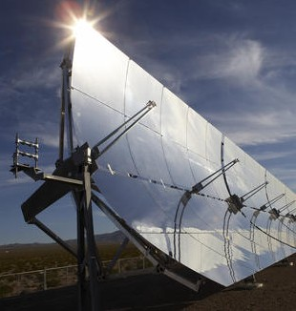
The sun it receives 0.3% of the surface of Sonora (604 square km) could generate all national electricity consumption.
Sonora gets an average insolation of 7 (kW·h/(m²·day) placing it in the list of states with higher electrical potential.
A heliostat (from helios the Greek word for sun, and stat, as in stationary) is a device that includes a mirror, which turns so as to keep reflecting sunlight toward a predetermined target.

Slide 8
Project Characteristics
16 heliostats installed.
A central tower has a height of 40 meters.
Heliostat size 36 square meters.
The area provided for this project is 40.5 hectares.

Slide 10
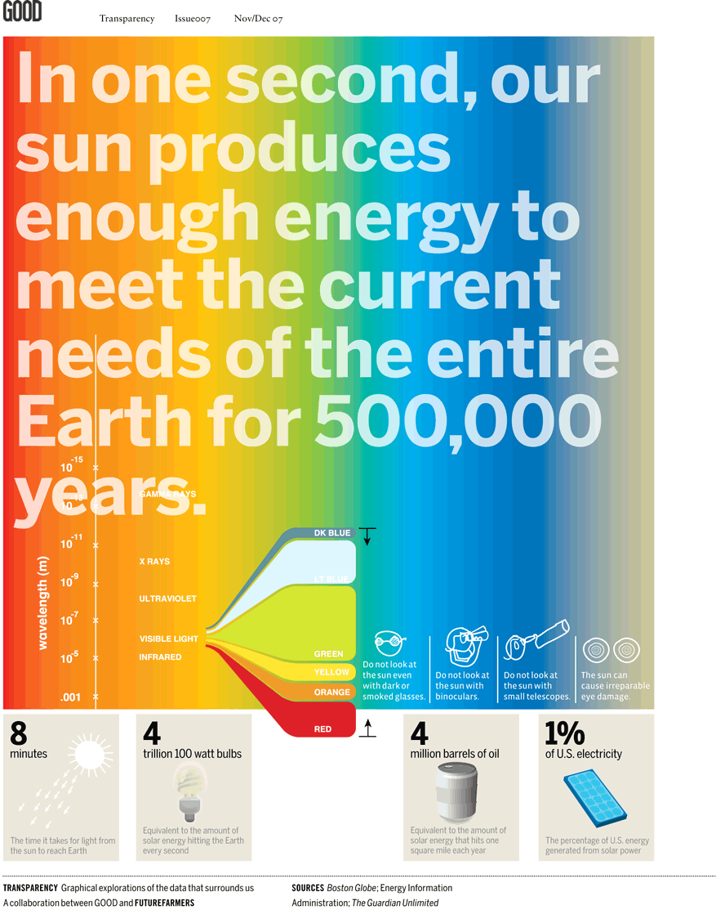

Slide 11
The available solar energy resources are 3.8 YJ/yr (120,000 TW). Less than 0.02% of available resources are sufficient to entirely replace fossil fuels and nuclear power as an energy source. Assuming that our rate of usage in 2005 remains constant, estimated reserves are accurate, and no new unplanned reserves are found, we will run out of conventional oil in 2045, and coal in 2159. In practice, neither will actually run out as natural constraints will force production to decline as the remaining reserves dwindle. The rate at which demand increases and reserves dwindle has been increasing dramatically because the rate of consumption is not constant. For example, if demand for oil doubled, reserves would not last as long. In addition, the cost of fossil fuels continues to rise while solar power becomes more economically viable.
In 2007 grid-connected photovoltaic electricity was the fastest growing energy source, with installations of all photovoltaics increasing by 83% in 2009 to bring the total installed capacity to 15 GW. Nearly half of the increase was in Germany, which is now the world's largest consumer of photovoltaic electricity (followed by Japan). Solar cell production increased by 50% in 2007, to 3,800 megawatts, and has been doubling every two years.
The consumption of solar hot water and solar space heating was estimated at 88 GWt (gigawatts of thermal power) in 2004. The heating of water for unglazed swimming pools is excluded.^{[3]}

Slide 12
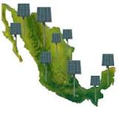
Solar Energy in Mexico
Solar potential in Mexico is the third biggest in the world. It is estimated that the Brute Solar Potencial is about 5kWh/m2 a day. In 2005 there were only 328 m2 of thermal solar panels and 115m2 of PV modules installed in Mexico. It’s expected that the installed capacity in 2013 grows to 25 MW with a generation of 14 GWh a year.

Slide 13
Quick Facts on Energy Consumption in Mexico
Coverage: 96% Total
Installed Capacity (July)2011: 51MW
Fossil Fuels Usage: 40.8%
Renewable Energy: 23.6%
Losses in Distribution: 15%
Usage per Capita: 1.801kWh

Slide 14
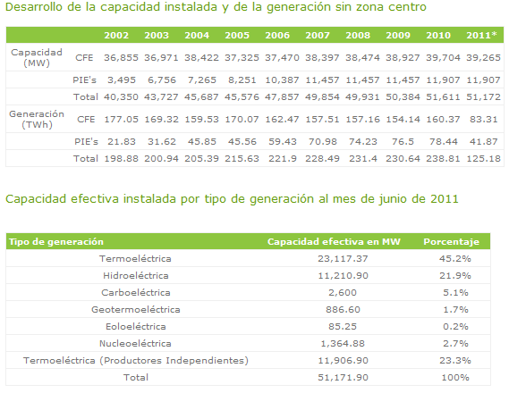
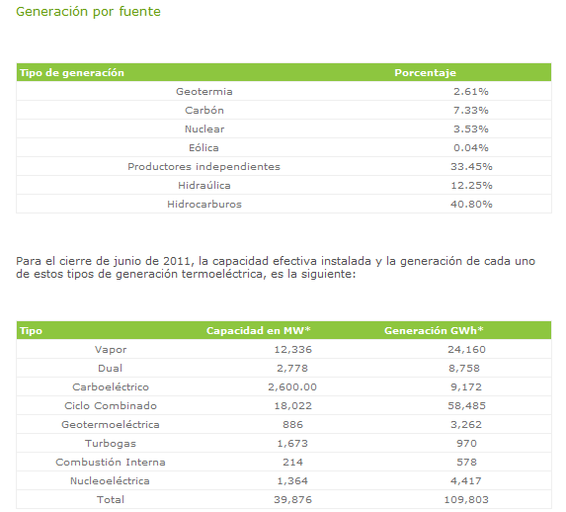
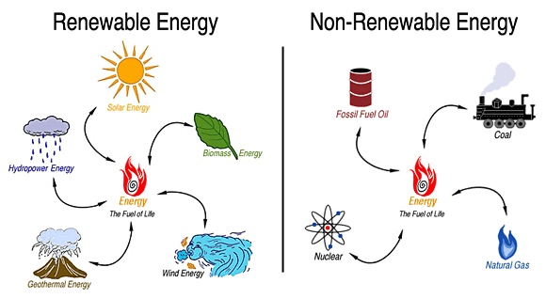

Slide 15
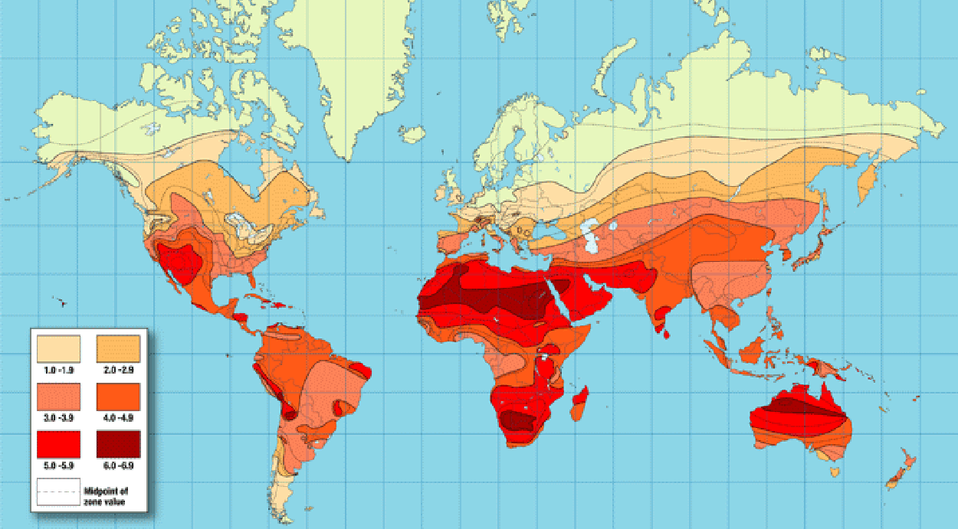
World Solar Insolation Map (kWh/m2/day)

Slide 16
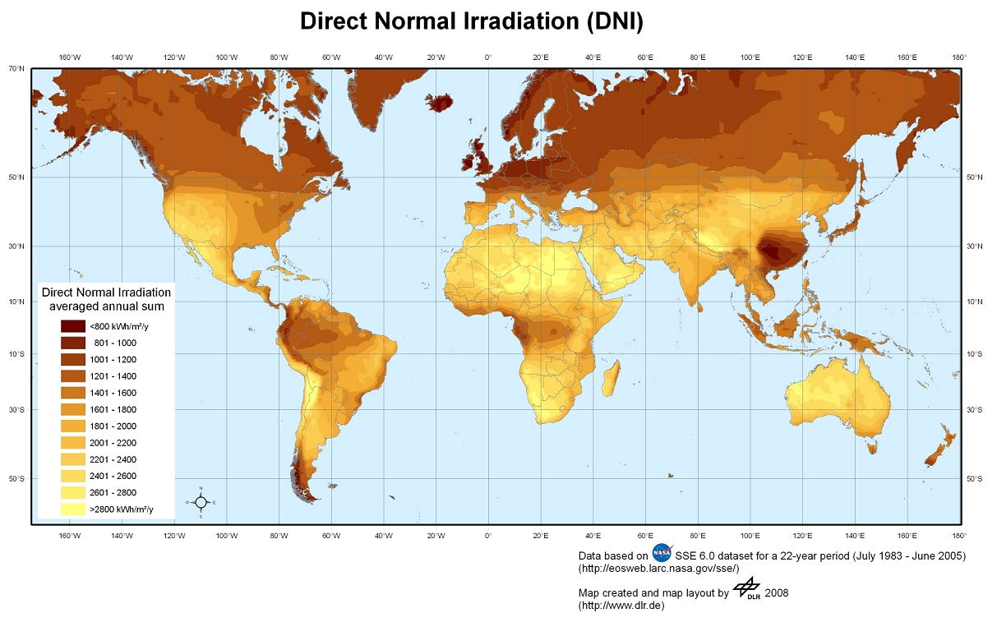

Slide 17
