Slide 1
Sustainable Renewable Energy for Rural Areas
Hydroelectric Power
Presented by: Kristen McLeod

Slide 2
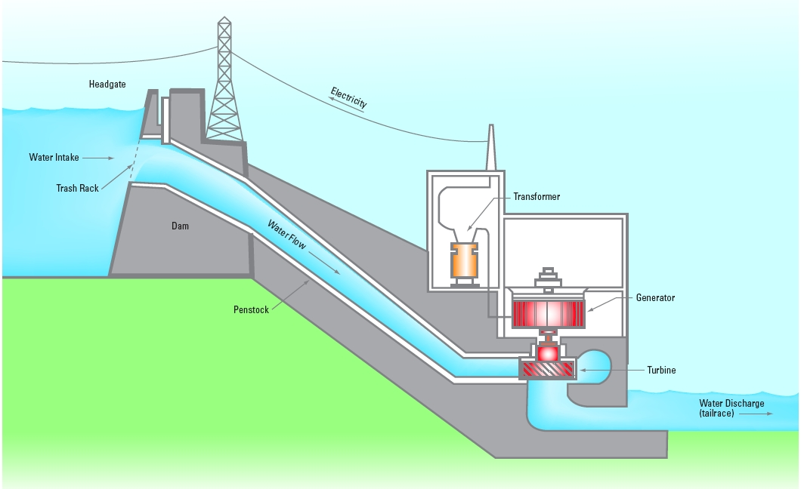
What is Hydroelectric Power?
Hydroelectric power can be described as the production of power by using the gravitational force of falling or flowing water. Most hydroelectric stations use either the natural drop of a river, such as a waterfall or rapids, or a dam is built across a river to raise the water level, and provide the drop needed to create a driving force. (Ontario Power Generation)
Currently it is the most widely used source of renewable energy.
Water is collected and flows through the station
and is carried down into a turbine. The turbine is
connected to a generator. As the water flows in,
water pressure increase causing the turbine to
revolve, which in turn spins the generator.
This produces electricity that can be stepped up
in voltage through the station’s transformers
and sent across transmissions lines.
The remaining falling water, having served its
purpose, exits the generating station,
where it rejoins the main stream of the river.
Source: Ontario Power Generation

Slide 3
The issue of access…
In today’s society access to energy is an important component for a societies'’ economic and industrial progress. Access to energy and power is vital if poverty and inequality is to be alleviated.
Access and consumption of power is unequal, with benefits falling to those in more urban and economically developed areas. According to Alazrague-Cherni 2008 article, the world’s richest countries which represent only 1/5 of the world’s population, account for more than half of commercial energy use.
For those living in rural and areas of low income, the main energy demand comes from cooking and the source of fuel utilized to satisfy this demand is fuel-wood, dung, and other forms of biomass. These are highly inefficient and polluting.

Slide 4
Benefits of Hydroelectric Power
Clean and renewable source of energy in replace of inefficient and environmentally unsound practices in rural communities.
Although limited it provides a source of jobs and economic opportunities.
Large potential market, especially within rural communities
Can range from small scale to large scale schemes and utilize a variety of water resources, such as dams, loch and run-of-river projects.

Slide 5
Drawbacks of Hydroelectric Power
Sites are usually remote and therefore limited in terms of their ability to attract visitors.
Limited on-going income and employment opportunities.
Large/costly start-up costs.
Can generate disputes over location in relation to protected land areas, especially for aboriginal people.
Exploitation of local people in rural areas, power being sent to most urban and economically advantaged areas.
Disruption of habitats and species within water systems.

Slide 6
Case Study: Moose River Basin
The Moose River Basin drains about 109,000 square kilometers in northeastern Ontario. The watershed is dominated by an extensive network of rivers and streams. All water within the system flows north and converges into the Moose River and eventually drains into James Bay.
Development of water dams began in the 1930s has transformed sections of the once free-flowing rivers into series of broad, deep runs and artificial lake. This was witnessed by the appearance of “islands” which were never present in the past and significant decreases in water levels.
Demand of clean and renewable energy is driving the creation of hydroelectric dams, especially within northeastern Ontario and rural areas. The Moose River in particular has the potential to provide approximately one-half of the province’s waterpower targets by 2025.
The river is home to diverse fish communities with approximately 15-28 known fish species. These include walleye, northern pike, whitefish, brook trout, and lake sturgeon etc.
Lake sturgeon especially are feeling the effects of the building of these water dams. This fish makes up a significant portion of the total mass of fish within the river. Lake sturgeon prefer life in open, big-river habitat but now face an uncertain future due to over-harvesting and habitat loss from the construction and operation of hydroelectric dams. These fish also have a large historical and dietary significant for First nation communities within the area.

