Slide 1
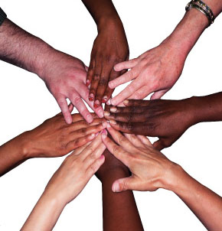
Michigan Tech Panel Discussion
“The secret of change is to focus all of your energy, not on fighting the old, but building the new.”-Socrates

Slide 2
Agenda
Welcome
Background
Introductions
Ground Rules
Panel Questions
Final Thoughts & Closing

Slide 3
Background
Offensive Halloween Costumes
During Halloween, students experienced offensive costumes being worn. Students were seen with painted “Black Faces,” illegal immigrant costumes, and confederate flags worn as capes.
Yik Yak Threat
On Thursday, November 12th , a threat was posted on Yik Yak by a Michigan Tech student saying “Gonna shoot all black people”
Insensitive Daily Bull Jokes
The Daily Bull posted

Slide 4
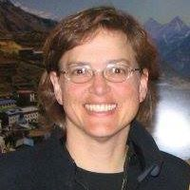
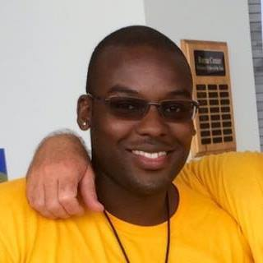
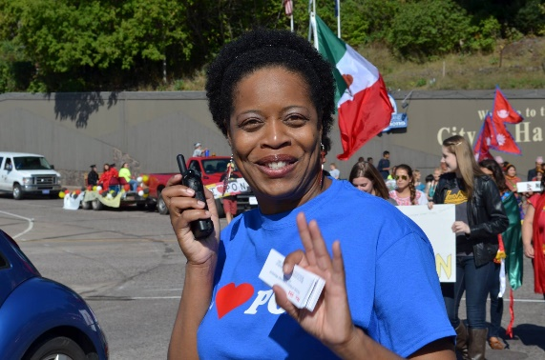
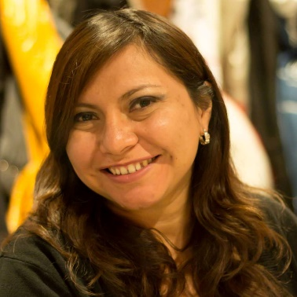
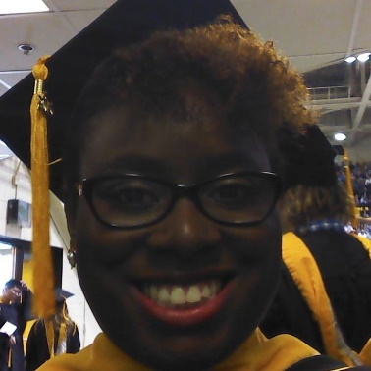
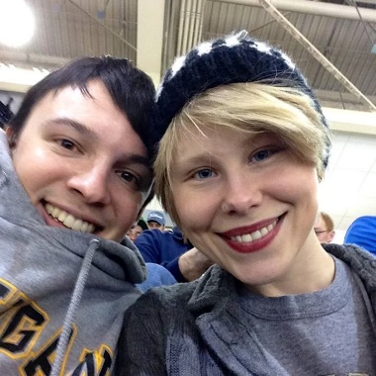
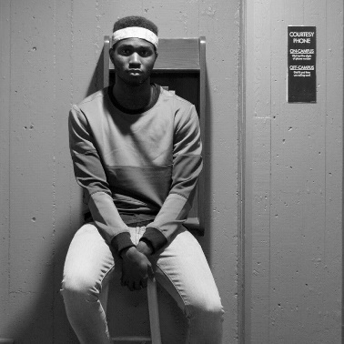
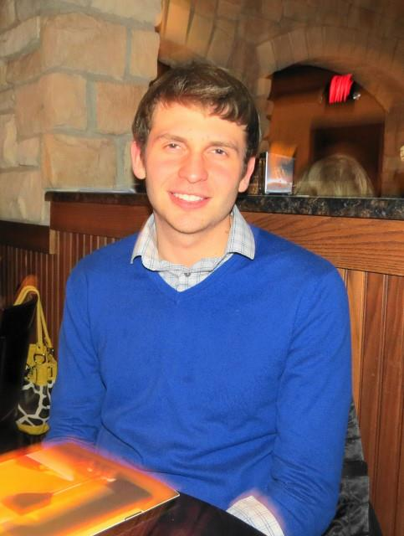
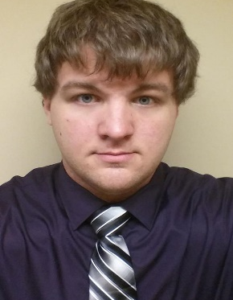
Meet Your Panel
Darnishia Slade
Mayra Gonzalez
Roneshia Strozier
Bonnie Gorman
Faith Morrison
Wesley McGowan
Chelsea Nikula
Nathan Shaiyen
Josh Krugh
Jacob Cavins

Slide 5
Discussion Ground Rules
Listen actively -- respect others when they are talking.
Speak from your own experience instead of generalizing ("I" instead of "they," "we," and "you").
Do not be afraid to respectfully challenge one another by asking questions, but refrain from personal attacks -- focus on ideas.
Participate to the fullest of your ability -- community growth depends on the inclusion of every individual voice.
Instead of invalidating somebody else's story with your own spin on her or his experience, share your own story and experience.
The goal is not to agree -- it is to gain a deeper understanding.
Be conscious of body language and nonverbal responses -- they can be as disrespectful as words.

Slide 6
Final Thoughts & Closing
“You can’t fix education until you fix the community, education is not a building but a lifestyle and an environment.”
-Robert John Meehan

