Slide 1
EUG/Clustering
Tutorial materials

Slide 2
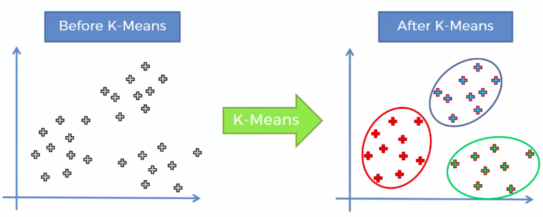
Cluster Algorithms
In this study, you will learn about clustering algorithms, and then try to answer some questions interpreting them.
The k-means clustering algorithm tries to identify if there are clusters of points in the data. A cluster is a set of points that are similar to one another, but dissimilar to points in other clusters.
The k-means algorithm cannot determine how many clusters exist. You tell it k, the number of clusters you want to use, and it gives you the best solution.
In the figure above, we see the data on the left. If we use k-means clustering with k=3, it finds the solution on the right.

Slide 3
Selecting k: The Number of Clusters
Often, there is not one clear answer for what k should be
The number of clusters is an INPUT to the k-means algorithm, not a output
It is up to the analyst to decide which k is the best
Sometimes, more than one solution can be reasonable
There are several criteria for knowing whether the solution is good:
The clusters should little overlap (segregation)
There should be gaps between clusters (separation; Between/Within SS)
The more clusters there are, we require stronger evidence (simplicity)

Slide 4
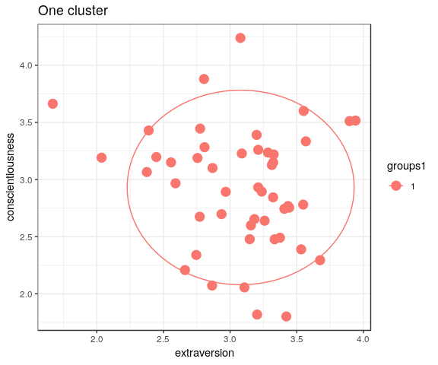
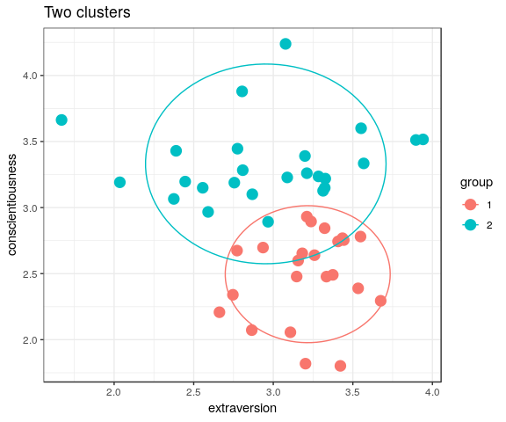
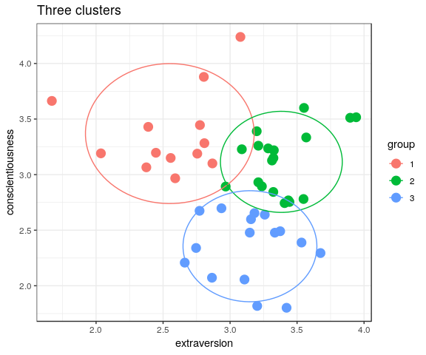
How many clusters are there?
Which figure above represents the most optimal clustering results?
Notes:
2 clusters example

Slide 5
Two cluster result:
The two subgroups are segregated (little overlap)
No separation between clusters
This shows an reasonable result.
Notes:
The clusters should no overlap very much (segregation)
There should be clear boundaries between clusters (separation; Between/Within SS)
The more clusters there are, we require stronger evidence (simplicity)

Slide 6
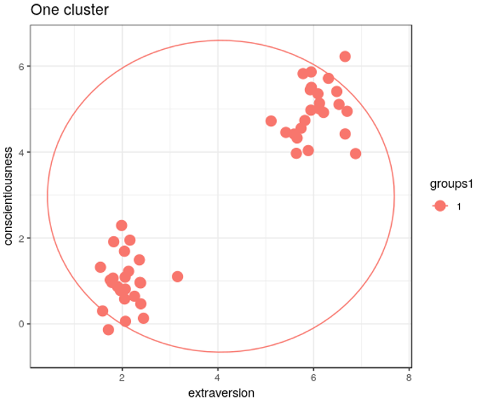
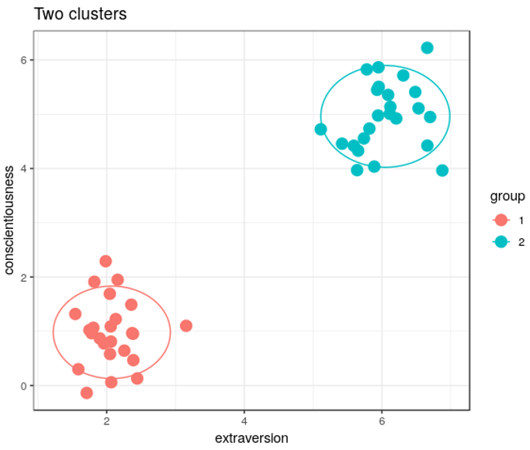
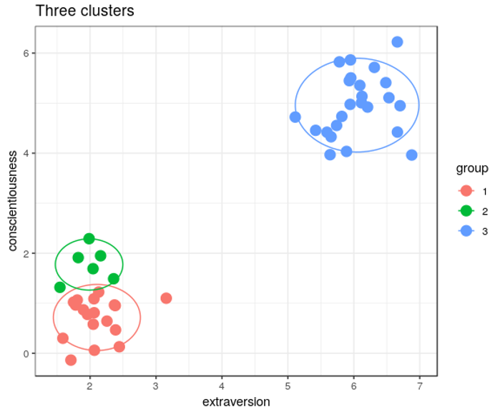
How many clusters are there?
Which figure above represents the most optimal clustering results?
Notes:
2 clusters example

Slide 7
Two Ks (clusters) result:
We can see clear boundaries between bottom-left and upper-right subgroups (separation).
We see no overlap (segregation) between two clusters.
This shows an optimal result.
Notes:
The clusters should no overlap very much (segregation)
There should be clear boundaries between clusters (separation; Between/Within SS)
The more clusters there are, we require stronger evidence (simplicity)

Slide 8
Three Ks (clusters) result:
We can see overlap between green and red clusters which means no clear segregation between them.
We see no clear boundary between green and red clusters, which means no clear separation between them.
This shows a poor result.
Notes:
The clusters should no overlap very much (segregation)
There should be clear boundaries between clusters (separation; Between/Within SS)
The more clusters there are, we require stronger evidence (simplicity)

Slide 9
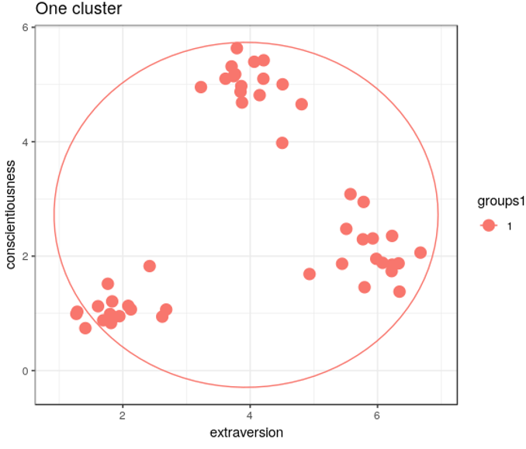
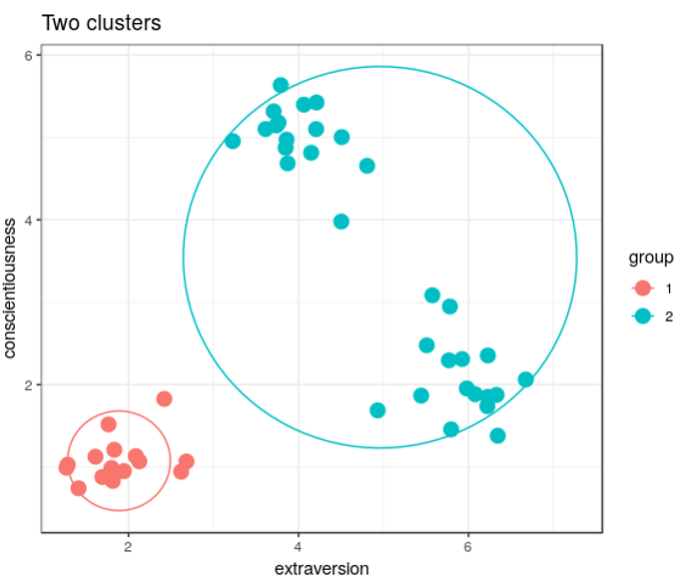
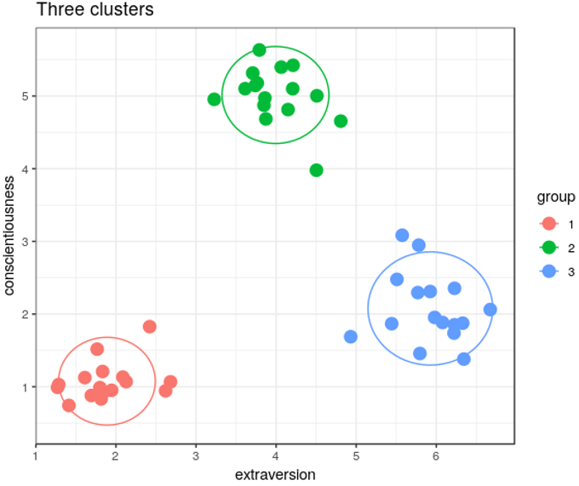
How many Ks (clusters) to choose?
Which figure above represents the most optimal clustering results?
Notes:
3 Ks example

Slide 10
Two Ks (clusters) result:
We can see clear boundary between blue and red clusters.
However, we can also see a clear boundary (separation) in blue cluster.
This shows an nonoptimal result.
Notes:
The clusters should no overlap very much (segregation)
There should be clear boundaries between clusters (separation; Between/Within SS)
The more clusters there are, we require stronger evidence (simplicity)

Slide 11
Three Ks (clusters) result:
We see clear boundaries (seperation) among three clusters.
In addition, we see a clear boundary (separation) between green and blue clusters (these two clusters were one cluster in 2 Ks solution).
This shows an optimal result.
Notes:
The clusters should no overlap very much (segregation)
There should be clear boundaries between clusters (separation; Between/Within SS)
The more clusters there are, we require stronger evidence (simplicity)

Slide 12
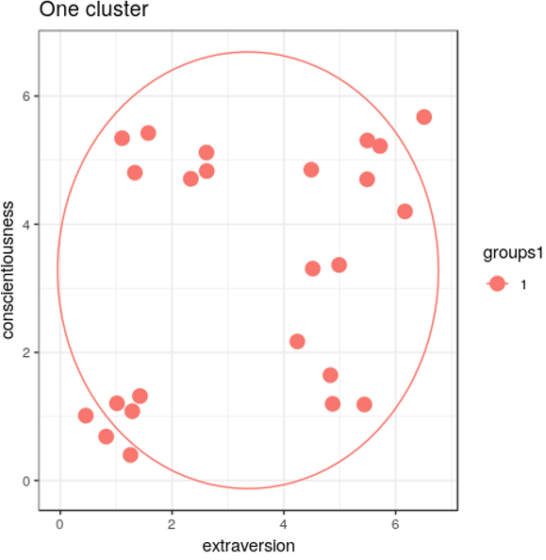
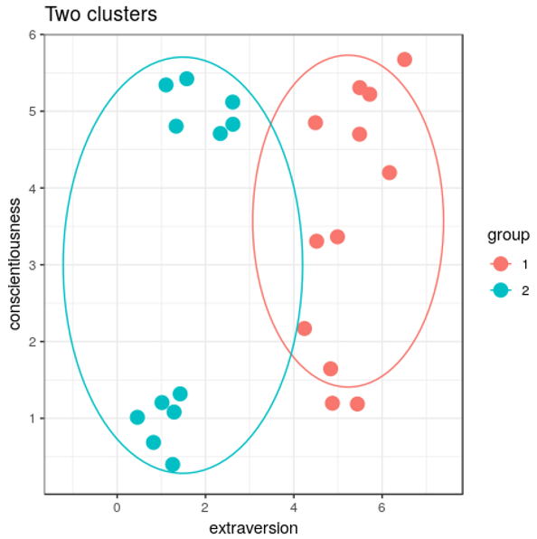
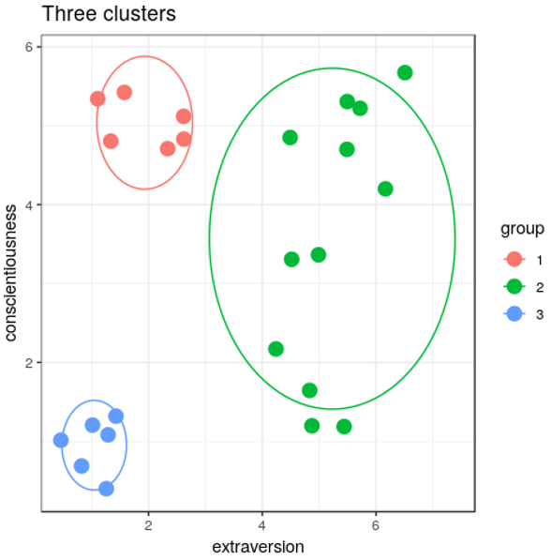
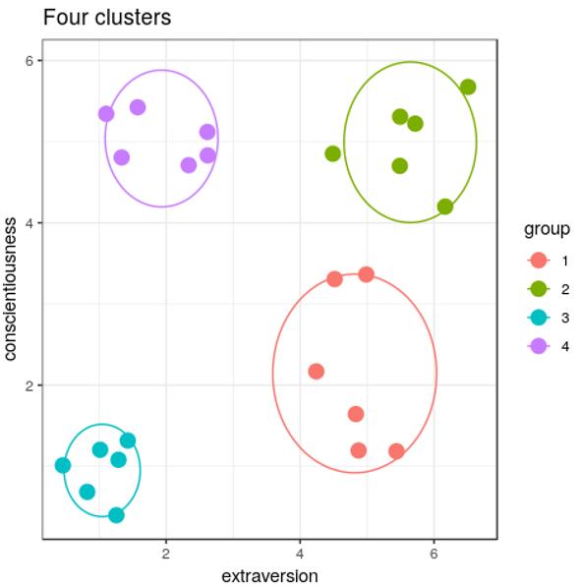
How many Ks (clusters) to choose?
Which figure above represents the most optimal clustering results?
Notes:
4 Ks example

Slide 13
Two Ks (clusters) result:
We can not see very clear boundaries between green and red clusters.
We see a slightly overlap between two cycles.
We can see clear separation in green cluster (upper vs. lower points)
This shows an not optimal result.
Notes:
The clusters should no overlap very much (segregation)
There should be clear boundaries between clusters (separation; Between/Within SS)
The more clusters there are, we require stronger evidence (simplicity)

Slide 14
Three Ks (clusters) result:
We can see no overlap among green, red, and blue clusters.
We see clear boundaries among three clusters.
However, we also see separation, quite clear boundary in green cluster, which means that it may be reasonable to separate green cluster.
This shows an ok but not optimal result.
Notes:
The clusters should no overlap very much (segregation)
There should be clear boundaries between clusters (separation; Between/Within SS)
The more clusters there are, we require stronger evidence (simplicity)

Slide 15
Four Ks (clusters) result:
We can see no overlap among green, red, blue, and purple clusters.
We see clear boundaries among four clusters.
We also see clear boundary (separation) between green and red clusters (these two clusters were one cluster in three Ks solution),
This shows an optimal result.
Notes:
The clusters should no overlap very much (segregation)
There should be clear boundaries between clusters (separation; Between/Within SS)
The more clusters there are, we require stronger evidence (simplicity)

