Slide 1
Teacher Workshop
Dr. Carla M. Koretsky
Department of Geosciences
Environmental Studies Program
Western Michigan University
July 18, 2011

Slide 2
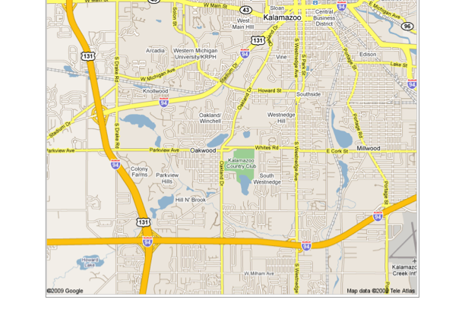
Big Idea?
Focus: Water Quality in a Local Lake (Woods Lake)
Woods
Lake

Slide 3
Today’s Schedule
8:30-10:30am: Rood Hall Classroom (here!)
10:30 am-2:15 pm: Divide into Groups A, K, Q
    Aces:
      10:30-11:30: Lunch
      12-1: Woods Lake
      1:15-2:15: Rood Hall Lab
    Kings:
      11-12: Woods Lake
      12:15-1:15: Rood Hall Lab
      1:15-2:15: Lunch
    Queens:
      10:30-11:30: Lunch
      11:30-12:30: Rood Hall Lab
      1-2: Woods Lake

Slide 4
Today’s Schedule
2:15-3:45 pm: Rood Hall Computer Lab
3:45-5 pm: Presentations/Discussions
    Aces:
      Temperature, Dissolved Oxygen
      dissolved manganese (Mn⁺²), dissolved iron (Fe⁺²), dissolved sulfide (H₂S)
    Kings:
      Temperature, Dissolved Oxygen
      Conductivity, dissolved chloride (Cl⁻), dissolved sodium (Na⁺)
    Queens:
      Temperature, Dissolved Oxygen
      pH, Dissolved phosphate (PO₄⁻³), dissolved ammonia (NH₃)

