Slide 1
Anthropogenic Eutrophication
Eutrophic: nutrient-rich
Eutrophication: natural process; over 1000’s of years, lakes fill in with sediment, become marshes, then dry land
Anthropogenic Eutrophication: same process, but speeded enormously by loading with “limiting nutrients” (typically P, sometimes N)

Slide 2
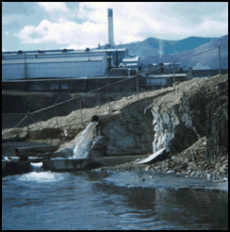
Sewage (P, N)
Treatment facilities – point source discharges
http://www.lrf.org/TMDL1print.html

Slide 3
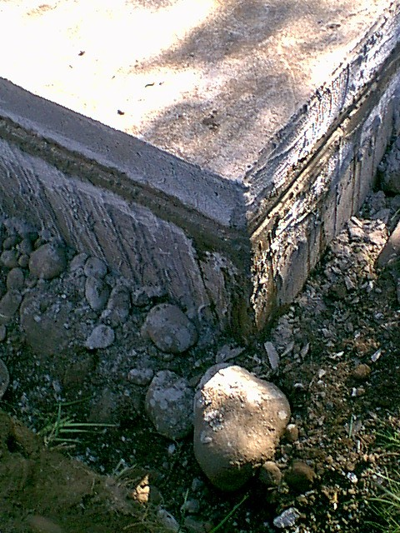
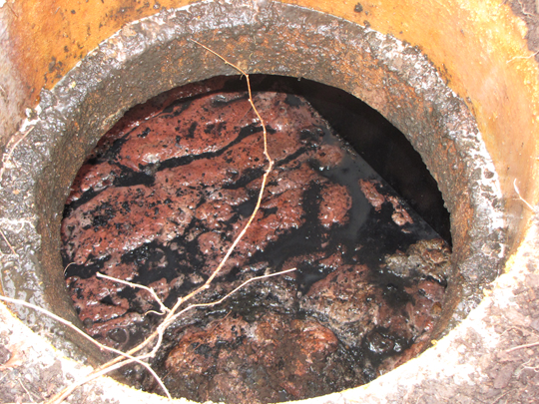
Sewage
Leaking Septic Tanks (N, P)
http://www.hallsservall.com/whatisaseptictank

Slide 4
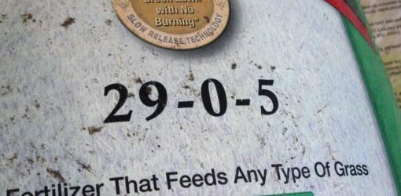
Fertilizers (N, P):
Residential & agricultural
“Zero in the middle!” – indicates no P
http://www.dannylipford.com/phosphorus-fertilizer-in-your-lawn-or-garden/

Slide 5
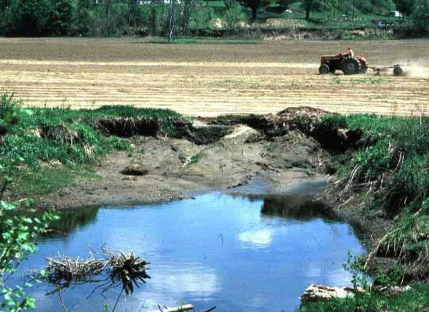
Major Sources of Nutrients (P, N):
Agricultural runoff (P, N)
http://oceanservice.noaa.gov/education/kits/pollution/media/supp_pol06a.html

Slide 6
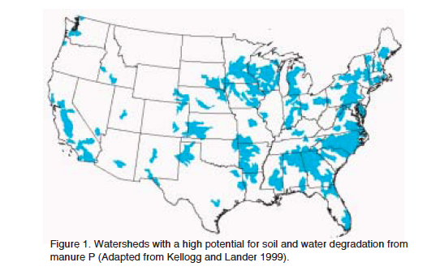
USDA 2003 Agricultural Phosphorous and Eutrophication

Slide 7
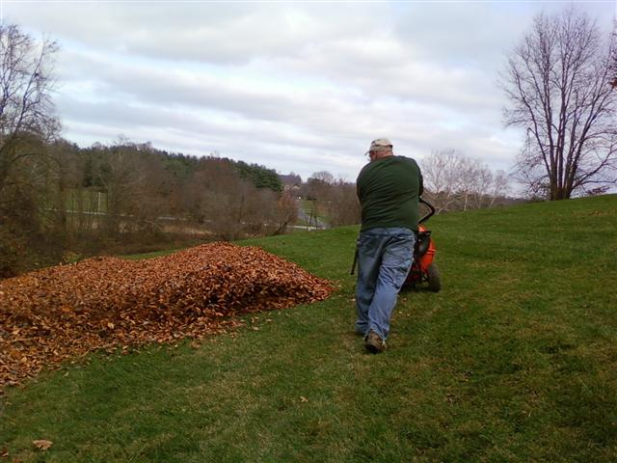
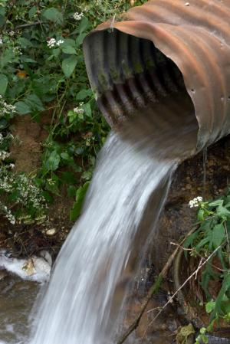
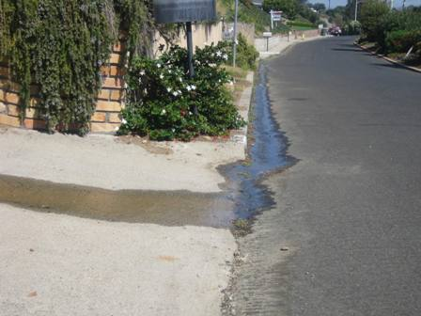
Residential runoff: lawn/leaf debris (P, N)
http://lawn-kingllc.com/
http://www.sciencedaily.com/releases
http://www.surfrider.org/ventura/Ocean%20Friendly%20Gardens.html

Slide 8
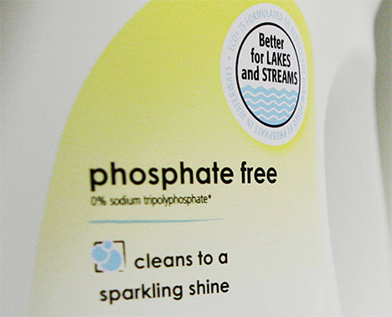
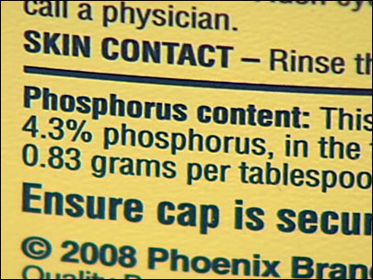
Detergents:
American Cleaning Institute recently announced voluntary ban on phosphates in household detergents
Already banned in > 15 states, including Michigan!
http://www.katu.com/news/local/97442189.html
http://agreenliving.org/finally-detergent-industry-puts-voluntary-ban-on-phosphates-in-household-dishwasher-detergents/

Slide 9
Excess Nutrient Loading: why it matters
Addition of “limiting” nutrient (P, N) stimulates organic matter productivity (photosynthesis)
Thick algal blooms develop, decreasing sunlight penetration
Lack of sunlight kills submerged aquatic vegetation (less oxygen input at depth, less fish/shellfish habitat)

Slide 10
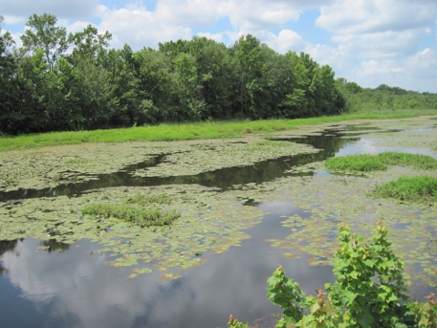
Photo from: Rutgers New Jersey Agricultural Experimental Station
Cooperative Extension of Salem County

Slide 11
Consequences
Increased organic matter production decreases dissolved oxygen (“DO” or O₂) concentrations
CH₂O + O₂ = CO₂ + H₂O
Drawdown of oxygen can lead to hypoxic (<2 mg/L or ppm DO) or anoxic (<0.2 mg/L or ppm DO) water – especially problematic in stagnant or poorly mixed water bodies
Hypoxia or anoxia kills fish (“healthy” water has ~8 mg/L DO; fish begin to die at ~2 mg/L DO)

Slide 12
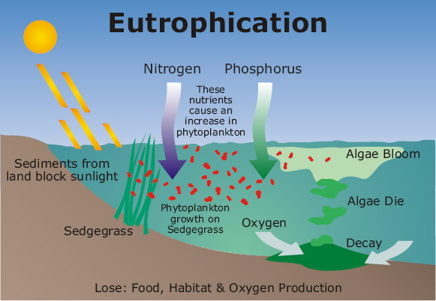
Diagram from: Lincoln.ne.gov

Slide 13
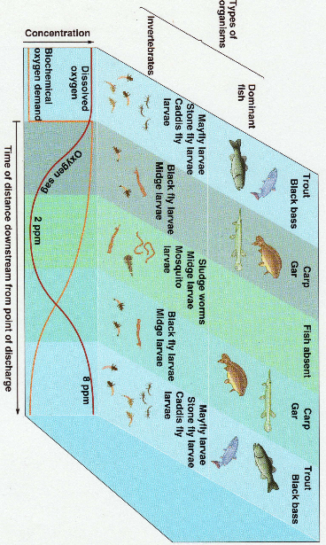
Oxygen “Sag” Curve in a River
BOD = biological oxygen demand; a good measure of quantity & quality of organic matter production
From: Chiras

Slide 14
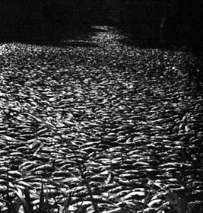
Hypoxia in Kalamazoo River
Photo taken in the 1950's showing a massive fish kill in the Kalamazoo River
http://www.wmich.edu/geology/gem/dataclearing/photos.html

Slide 15
Gulf of Mexico Hypoxia & Dead Zone
Causes
Physical Environment (quiescent waters; low winds, little water mixing)
Nutrient Enrichment: organic matter, nitrogen, phosphorous from agricultural runoff into Mississippi & Atchafalaya Rivers
Consequences
Largest hypoxic zone in the U.S.
16,000-20,000 km² since 1993 (up to size of New Jersey; largest in summer)

Slide 16
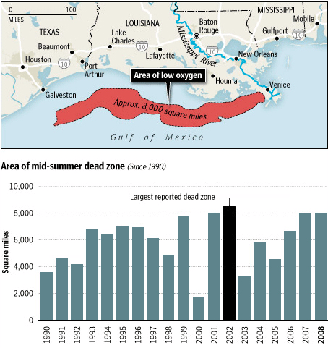
http://infranetlab.org/blog/2008/08/dead-zones/

Slide 17
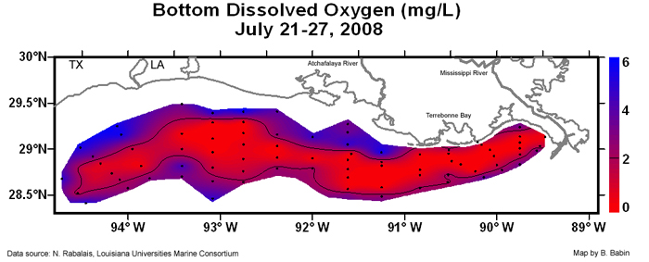

Slide 18
Lake Erie
Mostly “dead” in 1960’s, $8 billion spent to reduce point source sewage input (mostly removing P) as part of the 1972 Great Lakes Water Quality Agreement
Lake has been recovering (no algal blooms in 1980’s) – but slowly due to persistent cycling of P, even after P loading is greatly reduced
Recently (1990’s), increases in P loading and large algal blooms are occurring again, possibly also linked to zebra/quagga mussels

Slide 19
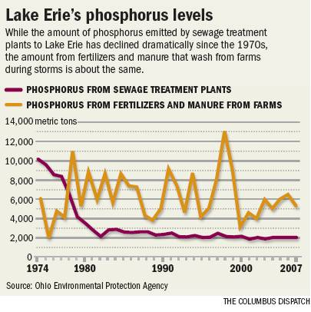
http://www.dispatch.com/live/content/local_news/stories/2010/05/08/toxic-algae-linked-to-farm-runoff.html#

Slide 20
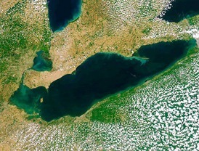
Lake Erie
Image Credit: Courtesy of MODIS Land Rapid Response Team, NASA/GSFC

Slide 21
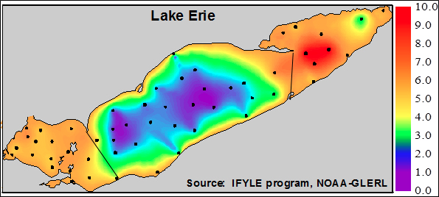
This image show interpolated bottom water oxygen concentrations in Lake Erie during September 2005.
Credit: Image by Stuart Ludsin
http://news.uns.purdue.edu/images/2011/hook-hypoxia.jpg

Slide 22
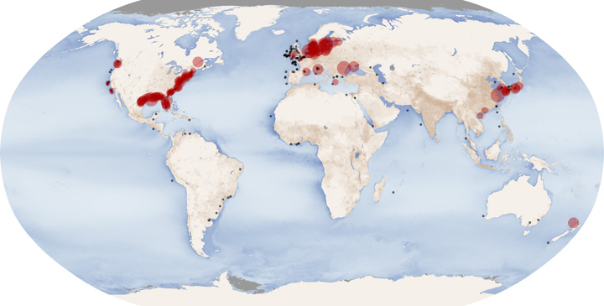
NASA Earth Observatory

Slide 25
Woods Lake
Photo Courtesy of Lynne Heasley

Slide 26
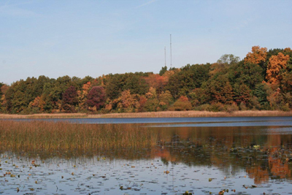
Asylum Lake
http://www.fm.wmich.edu/lss/natural_areas

Slide 27
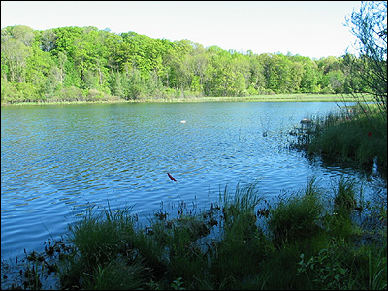
Brewster Lake
http://www.cedarcreekinstitute.org/

Slide 28
Van Dorn Sampler
Collect water at 1 m intervals
Alkalinity
Iron (Fe)
Manganese (Mn)
Phosphorous (P)
Ammonia (NH₃)
Sulfate (SO₄⁻²)
Sodium (Na)
Chloride (Cl)
Magnesium (Mg)
Potassium (K)
Calcium (Ca)

Slide 29
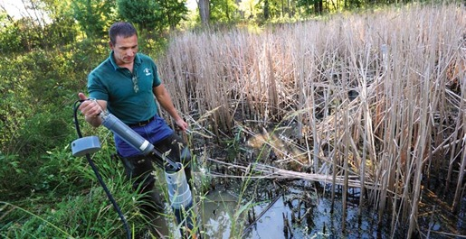
YSI Multisonde Probe
In situ measurements
Temperature
pH
Dissolved Oxygen
Conductivity
http://www.fondriest.com/news/pursuing-ecologys-digital-revolution.htm

Slide 30
Results: Temperature, Dissolved Oxygen

Slide 31
What happens when the oxygen runs out?
Anaerobic Respiration
Microbes “breathe” alternative compounds (nitrate, manganese (IV), iron (III) – rust!, sulfate)
Chemically reduced compounds persist in the water – ammonia, sulfide, manganese (II), iron (II)

Slide 32
Anoxic Lake Chemistry
“Reduced” solutes (ammonia, sulfide) are toxic to many organisms
Reduction of iron (III) to iron (II) and manganese (IV) to manganese (II) changes their form
Oxidized iron and manganese are solids
Reduced iron and manganese are dissolved

Slide 33
Results: Ammonia, Dissolved Manganese

Slide 34
Anoxic Lake Chemistry
Anaerobic respiration leads to dissolution of Fe and Mn oxide solids! Releases compounds bound to them into the water.
O
Pb
Pb
H
H
Pb in solution
Pb
Surface Bound
(Adsorbed) Ions
Lattice Bound (Co-Precipitated)

Slide 35
Dissolution of Iron and Manganese Oxides
Releases phosphorous into the water column
Creates a persistent “internal” nutrient load
Releases trace elements (Pb, Cd, Zn, …) into the water column
Many of these are toxic

Slide 36
Prevention
Reduce phosphorous in sewage effluent (point source treatment)
Reduce use of phosphorous in fertilizers, detergents
Control residential runoff (leaf, lawn waste)
Control agricultural runoff (no till, contour tillage, terracing, buffer strips)

Slide 37
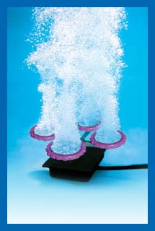
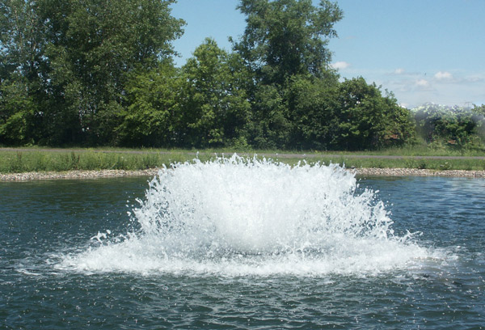
Remediation: Aeration Systems, Mechanical Mixing
http://www.pondsrxok.com/pond-aeration.html
http://www.lakework.com/site/aeration.php

Slide 38
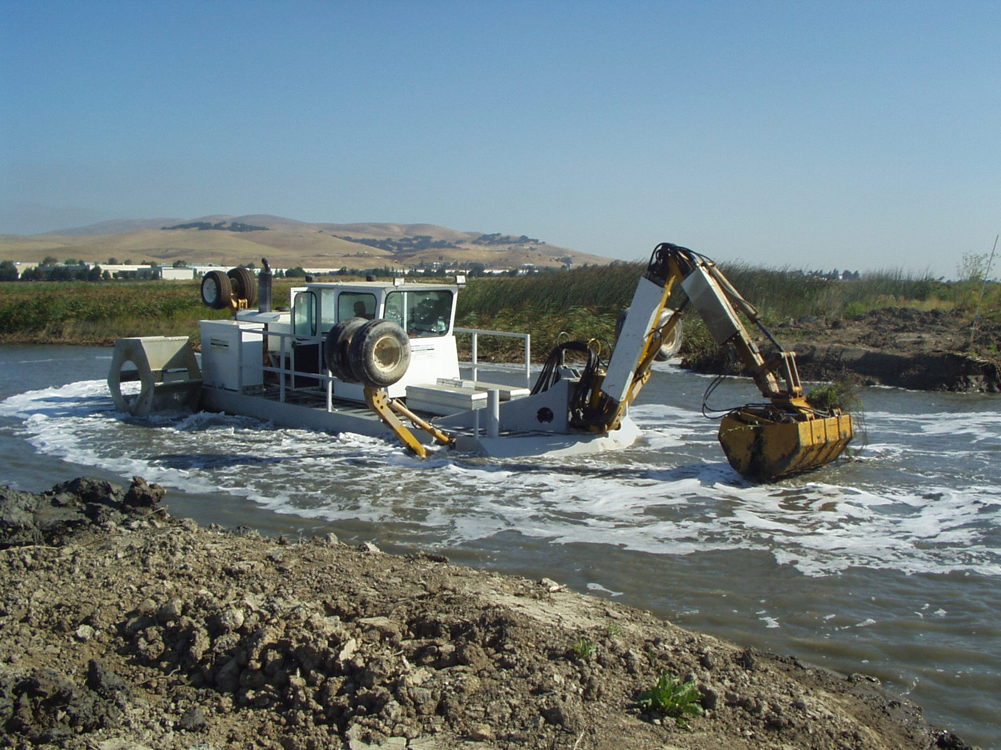
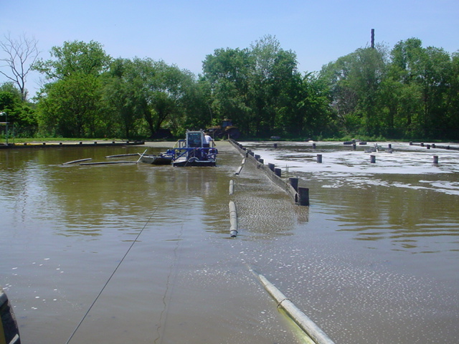
Remediation: Dredging
http://www.swampthing.us/Dredging_muck_removal_.html
http://www.environmentalleverage.com/Lagoon_wastewater.htm

Slide 39
Remediation Strategies
Alum treatments
Add soluble aluminum to bind up phosphorous
Algicides
Kill algae (mostly aesthetic)
Biomanipulation
Introduce organisms to eat algae

Slide 40
Road Salt
Sodium chloride (NaCl) used as a highway deicer since early 1940’s
Other deicers: calcium chloride, magnesium chloride, potassium acetate, calcium magnesium acetate
Annual production of salt in U.S. : ~50 million tons
~16,500,000 tons used for road salt in 2009

Slide 41
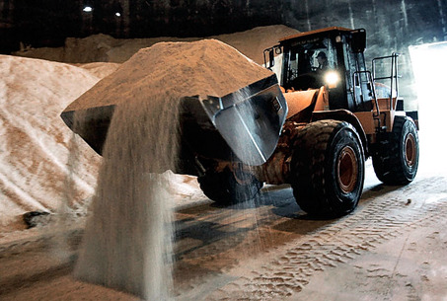
Data from Salt Institute
Photo: Paul Sancya / The Associated Press, 2008
Road salt is loaded at a Wayne County facility in Wayne, Mich.

Slide 42
Potential Consequences
Loss of potable freshwater supplies (salinization of groundwater, surface water)
Chronic or acute toxicity to freshwater biota
Decreases in biodiversity
Increases in invasive species
Increased metal toxicity
Changes in lake stratification

Slide 43
Urban (Kalamazoo) vs. Rural (Hastings)
Summer
2010
Summer
2010

Slide 44
Lake Mixing
Midwestern lakes are typically “dimictic”: mix from top to bottom in the fall and spring
Mixing occurs because of changes in temperature, density of waters
Cooler water = denser
Fall: surface waters cool, become more dense, sink
Spring: ice thaws, surface waters warm, wind mixes water column (all close to same temp)

Slide 45
Lake Mixing
In eutrophic lakes, mixing delivers oxygenated water to the lake bottom waters twice per year
Mixing removes ammonia, sulfide, other potentially toxic constituents of anoxic bottom water
Addition of road salt could theoretically slow or halt seasonal mixing (changes density structure)
Saline water = denser

Slide 48
Strategies
Prevention:
Less use of sodium chloride salt
Mixing with sand
Use of other deicers (CMA)
Rerouting of storm water
Remediation:
Few options, eventually mixes, dilutes

Slide 49
Today’s Plan
Measure in-situ profiles of temperature, dissolved oxygen, pH and conductivity at Woods Lake
Collect samples and measure dissolved iron (FeII) and manganese (MnII) in the laboratory

Slide 50
Today’s Plan
Compare data to prior measurements (last summer, fall, winter, spring)
Questions to consider:
Is Woods Lake stratified? Thermally? Chemically?
Does Woods Lake have high nutrient levels?
Is there evidence of road salt input at Woods Lake?
How might the water chemistry effect the lake ecosystem?

