Slide 1


Power System State Estimation Using Weighted Least Squares Algorithm
Done by,
Alorf, Abdulaziz A.
Banerjee, Bibaswan
April 27th, 2011

Slide 2



Least squares method application has started during that time.
1801
1960
State Estimation History

Slide 3
1801
Got incorporated in electric power systems when Prof. Schweppe and Prof. Handschin first published their paper on the topic.
1960
State Estimation History

Slide 4


The Main Idea of the Work

Slide 5
The Outlines of the Work
1) Some Explanations.
2) Objective.
3) Method Used for State Estimation.
- WLS (Weighted Least Squares).
4) Results.
- IEEE 14 Bus System.
5) Conclusions.
6) References.

Slide 6
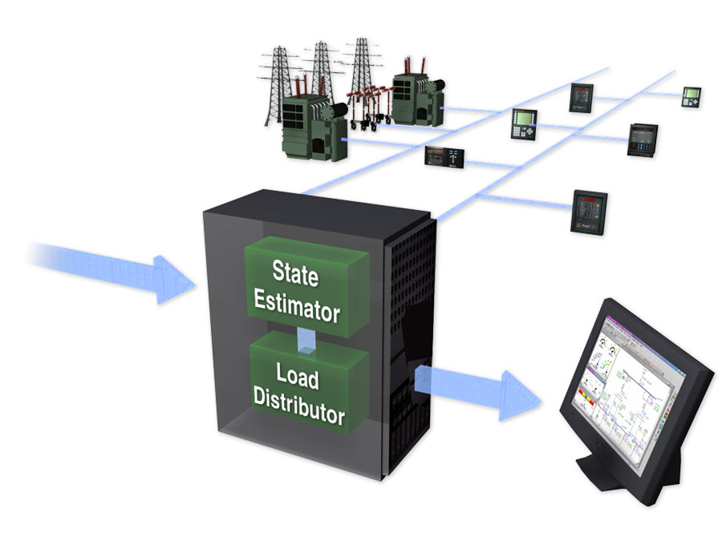
Some
Explanations
Objective
Method
Results
Conclusions
References
State variables are the voltage of the buses and relative phase angles at the respective nodes/buses.
Idea is to estimate (calculate) these values at each and every bus.
Input to the state estimator is measured data from available measuring devices located in different parts of the system.
The input data is processed by an algorithm in the control centers to estimate (calculate) the values of the state vectors.

Slide 7
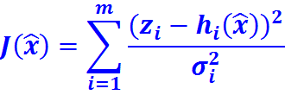


Some
Explanations
Objective
Method
Results
Conclusions
References
The objective is to estimate/calculate the values of the system state as follows:
Where,
is the estimated state vector of dimension m.
is the estimated measurement i.
is the measure value of the measurement i.
is the variance in the error in the measurement i.

Slide 8
Some
Explanations
Objective
Method
Results
Conclusions
References
WLS Algorithm
The measurement function is formed with help of measured data (line power flows, bus power injections, bus voltage magnitudes, and line current flow).
Form a Jacobian matrix by taking the partial derivative of the measurement function with respect to the state vector.
The gain matrix is formulated with Jacobian and error covariance matrix
End
Finally the solution is obtained from the gain matrix

Slide 9

Some
Explanations
Objective
Method
Results
Conclusions
References
WLS Algorithm (Cont.)
Initialize the state vector typically, as a flat start.
If no, update
and go to step 3. Else, Stop!
Calculate the gain matrix,
Test for convergence, max
Calculate
< ε?
Decompose
and
Solve for

Slide 10
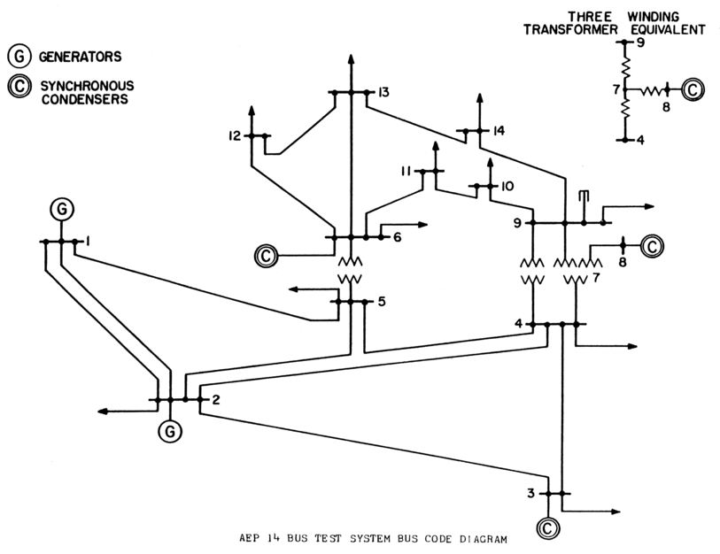
Some
Explanations
Objective
Results
Conclusions
References
Method

Slide 11

Some
Explanations
Objective
Results
Conclusions
References
Method
Measurement table for IEEE 14 bus system:
Sr. No | Measurement type | Value (p.u) | From bus | To bus
1 | 1 | 1.06 | 1 | 0 | 9e-4
2 | 2 | 0.1830 | 2 | 0 | 1e-4
3 | 2 | -0.9420 | 3 | 0 | 1e-4
4 | 2 | 0.00 | 7 | 0 | 1e-4
5 | 2 | 0.00 | 8 | 0 | 1e-4
6 | 2 | -0.0900 | 10 | 0 | 1e-4
7 | 2 | -0.0350 | 11 | 0 | 1e-4
8 | 2 | -0.0610 | 12 | 0 | 1e-4
9 | 2 | -0.1490/ | 14 | 0 | 1e-4
10 | 3 | 0.3523 | 2 | 0 | 1e-4
11 | 3 | 0.0876 | 3 | 0 | 1e-4
12 | 3 | 0.0000 | 7 | 0 | 1e-4
13 | 3 | 0.2103 | 8 | 0 | 1e-4
14 | 3 | -0.0580 | 10 | 0 | 1e-4
15 | 3 | -0.0180 | 11 | 0 | 1e-4

Slide 12
Some
Explanations
Objective
Results
Conclusions
References
Method
16 | 3 | -0.0160 | 12 | 0 | 1e-4
17 | 3 | -0.0500 | 14 | 0 | 1e-4
18 | 4 | 1.5708 | 1 | 2 | 64e-6
19 | 4 | 0.7340 | 2 | 3 | 64e-6
20 | 4 | -0.5427 | 4 | 2 | 64e-6
21 | 4 | 0.2707 | 4 | 7 | 64e-6
22 | 4 | 0.1546 | 4 | 9 | 64e-6
23 | 4 | -0.4081 | 5 | 2 | 64e-6
24 | 4 | 0.6006 | 5 | 4 | 64e-6
25 | 4 | 0.4589 | 5 | 6 | 64e-6
26 | 4 | 0.1834 | 6 | 13 | 64e-6
27 | 4 | 0.2707 | 7 | 9 | 64e-6
28 | 4 | -0.0816 | 11 | 6 | 64e-6
29 | 4 | 0.0188 | 12 | 13 | 64e-6
30 | 4 | 0.05634 | 13 | 14 | 64e-6
31 | 5 | -0.1748 | 1 | 2 | 64e-6
32 | 5 | 0.0594 | 2 | 3 | 64e-6

Slide 13
Some
Explanations
Objective
Results
Conclusions
References
Method
Result table for IEEE 14 bus system for no missing data:
Bus No. | Voltage (p.u) | Bus Angles θ (deg)
1 | 1.0084 | 0
2 | 0.9916 | -5.5085
3 | 0.9535 | -14.1561
4 | 0.9596 | -11.3767
5 | 0.9631 | -9.7254
6 | 1.0184 | -16.0092
7 | 0.9945 | -14.7122
8 | 1.0313 | -14.7130
9 | 0.9793 | -16.4687
10 | 0.9780 | -16.6975
11 | 0.9939 | -16.4770
12 | 1.0004 | -16.9482
13 | 0.9932 | -16.9807
14 | 0.9689 | -17.8608

Slide 14
Some
Explanations
Objective
Results
Conclusions
References
Method
Result table for IEEE 14 bus system when a bus data is missing:
Bus No. | Voltage (p.u) | Bus Angles θ (deg)
1 | 1.0068 | 0.0000
2 | 0.9899 | -5.5265
3 | 0.9518 | -14.2039
4 | 0.9579 | -11.4146
5 | 0.9615 | -9.7583
6 | 1.0185 | -16.0798
7 | 0.9919 | -14.7510
8 | 1.0287 | -14.7500
9 | 0.9763 | -16.5125
10 | 0.9758 | -16.7476
11 | 0.9932 | -16.5397
12 | 1.0009 | -17.0203
13 | 0.9940 | -17.0583

Slide 15
Some
Explanations
Objective
Results
Conclusions
References
Method
Result table for IEEE 14 bus system when some random line data is missing:
Bus No. | Voltage (p.u) | Bus Angles θ (deg)
1 | 1.0308 | 0.0000
2 | 1.0141 | -5.2644
3 | 0.9736 | -10.8803
4 | 0.9829 | -10.8803
5 | 0.9865 | -9.3051
6 | 1.0408 | -11.1377
7 | 1.0138 | -14.0619
8 | 1.0492 | -14.0608
9 | 0.9975 | -15.7489
10 | 0.9978 | -14.7092
11 | 1.0220 | -11.6952
12 | 1.0238 | -12.0232
13 | 1.0172 | -12.0531
14 | 1.0068 | -12.7111

Slide 16
Some
Explanations
Objective
Results
Conclusions
References
Method

Slide 17
Some
Explanations
Objective
Results
Conclusions
References
Method

Slide 18
Some
Explanations
Objective
Conclusions
References
Method
Results
1) The S.E. problem can be solved by WLS method with a good amount of accuracy.
2) However, the presence of any bad measurement cannot be identified in this algorithm.
3) When the measurements pertaining to one particular bus is missing the WLS algorithm reconstructs the system and give the estimates for the remaining buses.

Slide 19
Some
Explanations
Objective
Conclusions
References
Method
Results
4) When some random measurements are missing, they are not considered, keeping in mind that the system matrix does not become singular, and the WLS algorithm reconstructs the system and forms the estimates. These estimates when compared to the reference case (when all data are present), do not however give very good estimates as we are relying on lesser number of measured data for the estimates and this is bound to have some amount of error incorporated in it.

Slide 20
Some
Explanations
Objective
References
Method
Results
Conclusions
[1] Power Generation Operation and Control, Allen J. Wood, Bruce F. Wollenberg, Wiley and Sons, 1984.
[2] Power System State Estimation, Theory and Implementation, Ali Abur, Antonio Go`mez Expo`sito,Marcel
Dekker, Inc., 2004.
[3] M. E. El-Harway, Editor, ‘Bad Data Detection of Unequal Magnitudes in State Estimation of Power
systems’, Power Engineering Letters, IEEE Power Engineering Review, April 2002.
[4] Robert E. Larson, Member IEEE, William F. Tinney, Senior Member, IEEE, Laszlo P. Hajdu, Senior
Member, IEEE, and Dean S. Piercy, ‘State Estimation in Power Systems Part II: Implementation and
Application’, IEEE Transactions on Power Apparatus and Systems, Vol. PAS-89, No. 3,
March 1970, pp. 353 – 363.
[5] Calculations and Programs for Power System Networks, Y. Wallach, Prentice Hall, Englewood Cliffs,
New Jersey, 1986.
[6] Fred C. Schweppe, Member, IEEE, and Edmund J. Handschin, Member, IEEE, ‘Static State Estimation in
Electric Power Systems’, Proceedings of the IEEE, vol. 62, No. 7, July 1984, pp. 972 – 982.
[7] http://www.ee.washington.edu/research/pstca/pf14/pg_tca14bus.htm

Slide 21


Any
Question

