Slide 1
Improvement to Hessenberg Reduction
Shankar, Yang, Hao

Slide 2
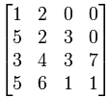
What is Hessenberg Matrix A special square matrix has zero entries below the first subdiagonal or above the first superdiagonal.

Slide 3
Why Hessenberg Matrix
Less computational efforts required for triangular matrix
Not convenient to convert to triangular directly then Hessenberg is a good transient form

Slide 4
Real life application
Earthquake modeling
Weather forecasting
Real world matrices are huge.
Dense solves are inefficient

Slide 5
Ways to convert to Hessenberg matrix
Householder Transform
Givens Rotation
Variants of the above (block forms etc)

Slide 6
Method 1: Householder Reflection
Setp1: Form Householder Matrix P₁ P₂
Setp2: Householder Reflection A=P₁AP₁⁻¹
Note: P₁ is orthogonal matrix, P₁=P₁⁻¹
A: 4 by 4 random matrix
A
A= P₂P₁AP₁P₂
Original Matrix
Final Matrix
Target :Zero these entries
P1
P2

Slide 7
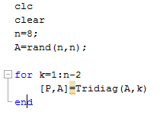
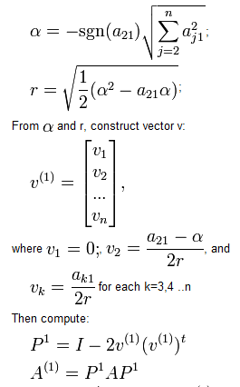
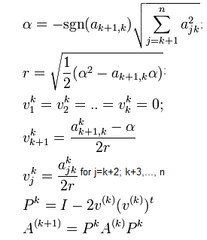
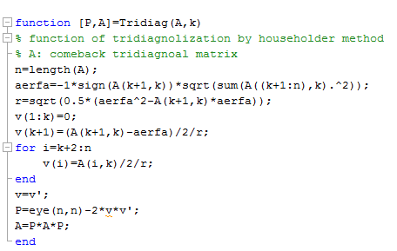
How to form Householder Matrix
Code
Initial Operation
Loop it

Slide 8
Example
Householder Transform
A 8x8 Random Square Matrix =
Loop1: A₁=P₁AP₁
Loop2: A₂=P₂A₁P₂
Loop3: A₃=P₃A₂P₃
Loop4: A₄=P₄A₃P₄
Loop5: A₅=P₅A₄P₅
Loop6: A₆=P₆A₅P₆
Notes:
Show you code, numbers

Slide 9
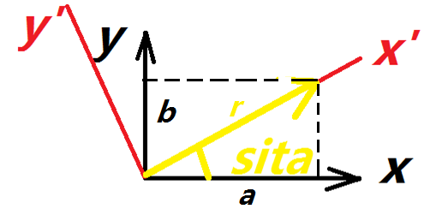
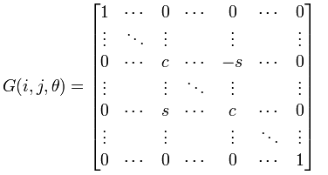
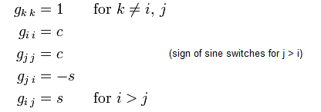
Method 2: Givens Rotation
General Idea: Coordinate Transform, xy to x’y’, zeros one of axis component
Suppose vector v=(a,b) in xy coordinate and rotation matrix G between xy and x’y’
Two Degree Coordinate
Where
Expand to N Degree Coordinate

Slide 10
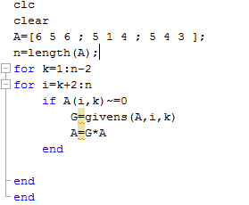
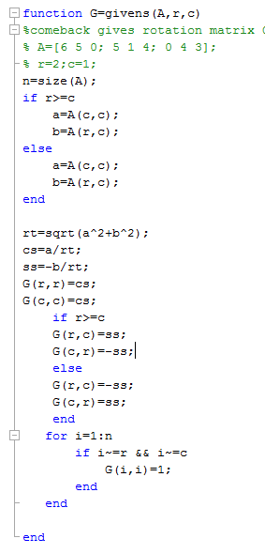
Code by Matlab
Example
Original Matrix
Resulted Matrix
Zero this entry

Slide 11
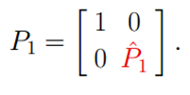
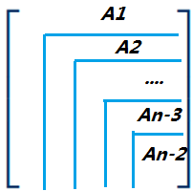
Implemetion1: Hessenburg Reduction by using Householder Matrix
General Householder Reflection
A
P₁AP₁
Full Again
Solution: Hessenburg Reduction
Form the Householder matrix from A (n-1) by (n-1) change the householder matrix as:
First Transform Matrix
First Transform
A1=A (n-1,n-1)
Iteration
A2=A (n-2,n-2)
…
An-2

Slide 12
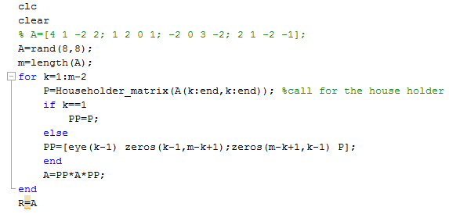
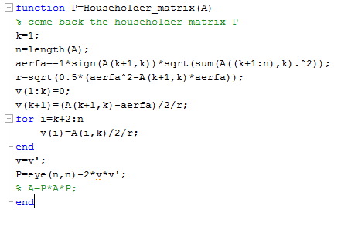
Hessenburg Reduction by Matlab

Slide 13
Hessenburg Reduction
A 8x8 Random Square Matrix =
Loop1
Loop2
Loop3
Loop4
Loop5
Loop6
Notes:
Show the code

Slide 14
Givens Rotation
function [g]=givens(x,j,i)
% Function of Givens Rotation
% x: Input matrix
% i: Row affected by the zeroing operation
% j: Row to be zeroed (column 1)
% G: Givens rotation matrix
g=eye(length(x)); %Initialize givens matrix
xi=x(i,1); %Identify the ordinate pair over which the rotation happens
xj=x(j,1);
r=sqrt(xi^2+xj^2); %Find length of vector r from origin to this point
%Populate rotation matrix with the necessary elements
cost=xi/r;
sint=xj/r;
g(i,i)=cost;
g(i,j)=-sint;
g(j,i)=sint;
g(j,j)=cost;
end

Slide 15
Hessenberg Reduction through Givens Rotation
function [R]=hessen1(A)
% Hessenberg Reduction by using Givens Method
count=1;
n=size(A);
G=eye(size(A)); %Gives rotation matrix accumulator
R=A; %Copy A into R
for j=1:n-2 %Outer loop (determines columns being zeroed out)
for i=n:-1:j+2 %Inner loop (successively zeroes jth column)
giv=givens(R(j:n, j:n), i-j+1, i-j);
giv=blkdiag(eye(j-1), giv); %Resize rotator to full size
G=giv*G; %Accumulate G which give a Q in the end
%Perform similarity transform
R=giv'*R;
R=R*giv;
count=count+1;
end
end
end

Slide 16
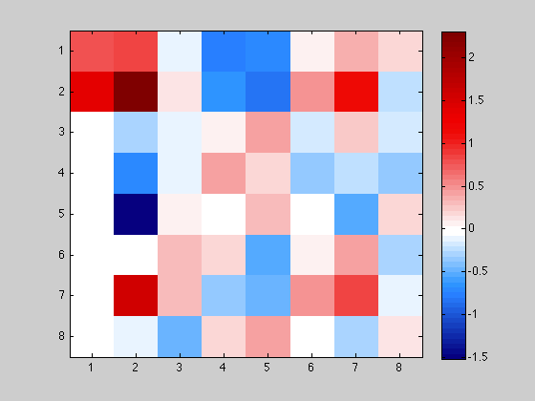
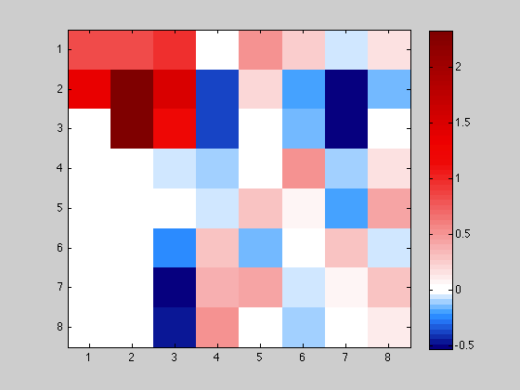
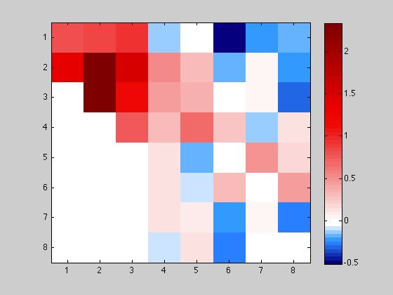
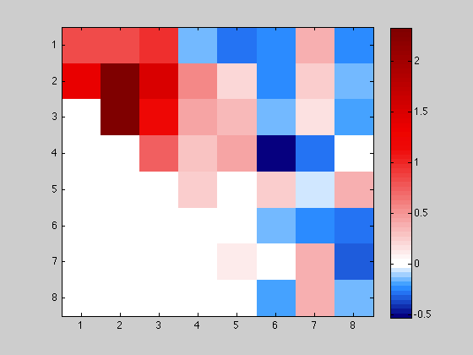
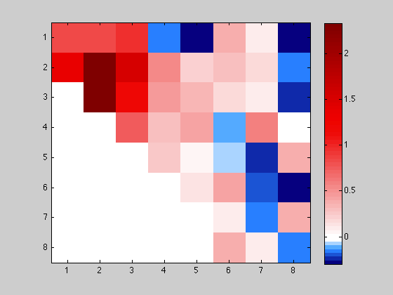
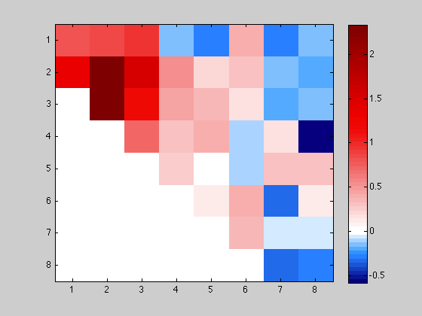
Result

Slide 17
Performance Improvement Criteria
CPU
Cache Locality
Memory Bandwidth
Memory bound
Computational Efficiency (Number of calcs)
Size of data
GPU
Large latency overhead
Memory Bandwidth
Memory bound
Parallelization Algorithms
GPU Targetting

Slide 18
Blocked Operations (SIMD)
Operate on large chunks of data
Provides cache locality
No pipeline bubbles
Streaming extensions (SSEx) on modern processors target these operations
Order of efficiency (ascending)
Vector-Vector (Level 1)
Vector-Matrix (Level 2)
Matrix-Matrix (Level 3)

Slide 19
Parallel Operations
Modern CPUs can operate on two/more sets of data simultaneously and independently
Still share memory, so cache locality still important
Important: Algorithm needs to be rewritten to find independent operations without dependencies on previous values
Synchronization very important
GPU perfect for this, massively parallel processing pipeline (‘stream processors’)
ASIC(Application Specific Ics) and FPGAs (Field Programmable Gate Arrays) are perfect for this

Slide 20
Block Hessenberg

Slide 21
Results

Slide 22
Results
norm1 =
0
norm2 =
6.013108476912430e-13
norm3 =
66.823468331017068
eig_norm =
0
eig_norm1 =
4.965725351883417e-14
eig_norm2 =
5.924617829737880e-14

Slide 23
Conclusion
Hessenberg Reduction reduces complexity of dense eigen value solvers
Column householder and Givens rotation
Study of computing architecture tells us how to improve performance
Blocking (SIMD) and parallelism
Blocking algorithm fastest

