Slide 1
Introduction to Data Management Planning
Van Pelt & Opie Library

Slide 2
Objectives
Understand the basics of a data management plan
Recognize the value of a good data management plan
Know where to get additional help locally and beyond
Notes:
Many research proposals require a data management plan or DMP. This session will cover the basics of data management planning including agency requirements, the elements of a good data management plan, and best practices in creating a plan. As an introduction to DMPs, this session will benefit both new research faculty and graduate students. At the end of this workshop, attendees will be able to define the basic elements of a data management plan, identify the benefits of having a good data management plan, and discover campus and national resources available for assistance in creating a data management plan.

Slide 3
Data Management Plan (DMP)
A formal document that identifies, describes and explains what the data is, its organization, and how it will be generated and used throughout a project
DMPs are required by many funding agencies to ensure that data is shared and made available for future researchers
A good DMP not only meets a funder’s obligation, but is also a powerful tool for the researchers during a project’s lifecycle

Slide 4
What’s required in a DMP?
Roles and responsibilities
Expected data used/produced
Period of data retention
Formats and metadata
Management and storage
Sharing and preservation
Notes:
You will describe the who, what, when, where and how of your project’s data

Slide 5
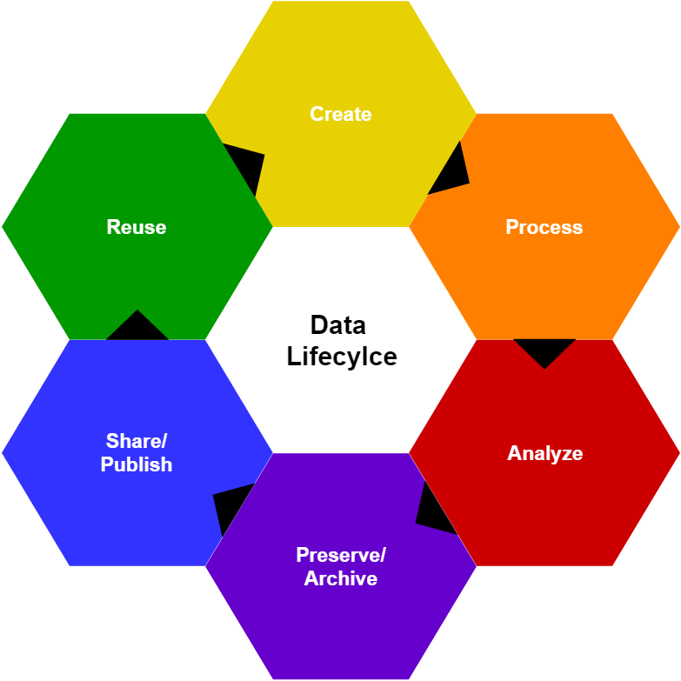
Data Management Plan (DMP)
Funders want to know:
What actions are taken during each step of the lifecycle to enable data sharing?
Notes:
Preserve/Archive is first so that people who encounter your work will have ready access to the data

Slide 6
DMP Benefits
Conduct research more efficiently
Creating a guide for data handling during a project
Facilitates the data sharing process
Notes:
Conduct research more efficiently and effectively by planning how to use the data produced during the research process Informs collaborators on the project
Reusable record of data for future self and others - Managing research data throughout its lifecycle enables its subsequent access and reuse (data sharing).

Slide 7
What’s required in a DMP?
Specific requirements are found in solicitations for proposals or within the policies of the granting agency
Some DMP guides or tools incorporate any specific requirements into their templates
Notes:
There are also directories and sites that include funder requirements, but checking directly with the funder ensures currency of information (usually)
We will talk about some of these tools at the end of the presentation

Slide 8
Data Products and Standards
Input/Output datasets
Existing datasets to be used and datasets to be created
Formats
Software, programming languages
Only those used to perform research actions
Estimated Amounts/Sizes
Can be expressed as rate produced
Whether any datasets or files will be shared
Notes:
Examples: transcripts, tables 3D models, digital audio, geospatial, physical samples or collections
Examples: RFT text, CSV, PNG, MPEG, etc.
Example: 1 TB/year, 50GB/experiment

Slide 9
Data Products and Standards
Datasets | Formats | Est. Size/Amount | Shared?
Weather data from NOAA | netCDF | 10 GB | Maybe
Climate Model Output | netCDF | 1 TB | Yes
Software | Programming Lang | Est Size/No. Files | Shared?
R Code for climate model analysis | .R | .1 MB | Yes
Johns Hopkins Data Management Services. (2017) “Data Management Planning Questionnaire” Johns Hopkins University Sheridan Libraries. Revised 02/10/2017. https://osf.io/ubkvc/ This work is licensed under the Creative Commons Attribution--Noncommercial 4.0: https://creativecommons.org/licenses/by-nc/4.0/
Notes:
Consider using a table to display these elements in your DMP
Datasets - input and output.
Software - what is needed to make use of the data?

Slide 10
Metadata
Information needed to find, evaluate, understand, re-use research data
“Data about data”
Notes:
Standardized metadata is really good

Slide 11
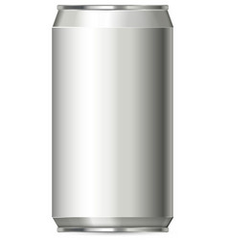
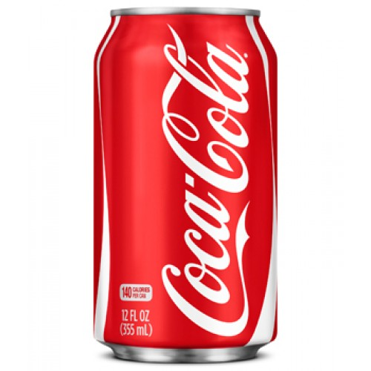
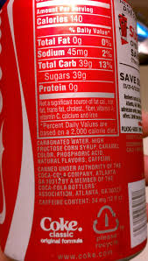
Metadata
NONE
BETTER
BEST
Notes:
First pic: we have no way of knowing what’s in the can, no metadata
2nd pic: Some metadata, we know contents and brand and size
3rd pic: We know contents in detail, producer, and effects of contents (nutritional values)
Best of all, this information is standardized so I can compare different soft drinks using the same criteria.

Slide 12
Metadata
Is there a metadata standard for your discipline?
Check the Metadata Standards Directory: http://rd-alliance.github.io/metadata-directory/standards/
Be sure to include the name of the standard used in your DMP
DDI (Data Documentation Initiative) - social, behavioral, and economic sciences
Dublin Core - A basic, domain-agnostic standard

Slide 13
Metadata – key elements
Develop naming conventions for folders and files
Essential for identifying and organizing files
Remain consistent!
Elements can include
date of creation
name of researcher
data collection method
version number
stick with letters, numbers, and underscores
only use a period when distinguishing between a file’s name and extension
“image_webcam_Watkins_023_01282019.jpg”
Notes:
Consistent and systematic, Quick and easy access in the future; understood by collaborators, others and your future self (Got time?)

Slide 14
Metadata – key elements
Version Control
Especially necessary when working with collaborators
Key Elements:
Save every change as a new version, even minor
Use ordinal numbers (1,2,3) for major version changes
Use decimal for minor changes
“v1, v1.1, v1.2, etc.”
Avoid imprecise labels: copy 1, definitive_copy
Notes:
Will you remember differences a year from now? Can your collaborators locate the file they need easily?

Slide 15
Metadata - advice to consider from the
Director of Research Computing
Include a top-level README.txt (or README.md) for each project
Use a sublevel README for subprojects
At project completion - compress top-level folders into a space saving entity
.zip
tar.gz
tar.bz2
Notes:
Provide users the necessary information/context to understand your data
Gowtham, director of research computing

Slide 16
Management and Storing of Data
How (media or format) and where (location) will the project data/code be stored and backed-up?
Who will be responsible for this process? Will responsibilities change as the project progresses?
Notes:
This is during the life of your research project – short term

Slide 17
Management and Storing of Data
Keep at least three (3) copies of data
Original files
Main backup files (local server)
Remote external storage
Check with funding agency guidelines if using Cloud-based solution
Notes:
This is during the life of your research project – short term
Consider collaboration needs when deciding where to store original files
Remote external applies to off-site (don’t have everything in same building, or campus)
Some agencies have restrictions on data storage outside the US

Slide 18
Management and Storing of Data: Security
Some data require security measures to protect human subjects, national security, intellectual property
Measures include
Data encryption
Password/dual authentication access
Firewalls
Security updates
Notes:
Examples: PII, PHI, HIPPA, IRB
IT can help with security measures

Slide 19
Data Sharing and Preservation - why?
Shared datasets, like articles, are cited and add to your impact as a researcher
Allows future research to naturally follow
Adds to the historical record of your discipline
Sharing = Knowledge
Notes:
Making data available long-term Why? Benefits!
More recognition
Future researchers (including you) don’t have to start from scratch
Historical record useful to future researchers in and outside your discipline
Sharing empowers knowledge, no research happens in a vacuum, unless it’s research in a vacuum…

Slide 20
Data Sharing and Preservation: what to share
“Share the data sufficient to support the findings of the research”
Examples
Aggregate data
De-identified case examples
Teaching materials
What level of data sharing is expected within your discipline?
Notes:
Funders don’t require all the data, just the necessary data
Is there an expectation within your discipline?

Slide 21
Data Sharing and Preservation: Key Elements
Which data will be shared? Preserved?
Who is the expected user of the data?
How should the data be cited?
Where will you share?
Notes:
Everything? Only what’s essential?
Sharing and Preserving can be tackled separately or at once
Colleagues in discipline, but perhaps others as well
Citing your data is important, persistent identifiers are preferred

Slide 22
Data Sharing and Preservation: How? Where?
File sharing service
Publish with journal article
Difficult to cite the data
Request directly from PI
Notes:
File sharing service – check out the security and duration
Published with article – short term, no standard on retention of data files in publishing
When data security is an issue, not really a long-term solution

Slide 23
Data Sharing and Preservation: How? Where?
Archives/Repositories – best for preservation
Does your discipline have an archive?
Does your funding agency have a repository?
Check:
The Registry of Research Data Repositories (re3data):
https://www.re3data.org/
The Open Access Directory (OAD) of Disciplinary Repositories: http://oad.simmons.edu/oadwiki/Disciplinary_repositories
Your institution does!
Digital Commons @ Michigan Tech: digitalcommons.mtu.edu
Notes:
Does your funder mandate one?
Discipline specific good for colleagues
Institutional pulls together all your works, broader discovery via google
The library can help!

Slide 24
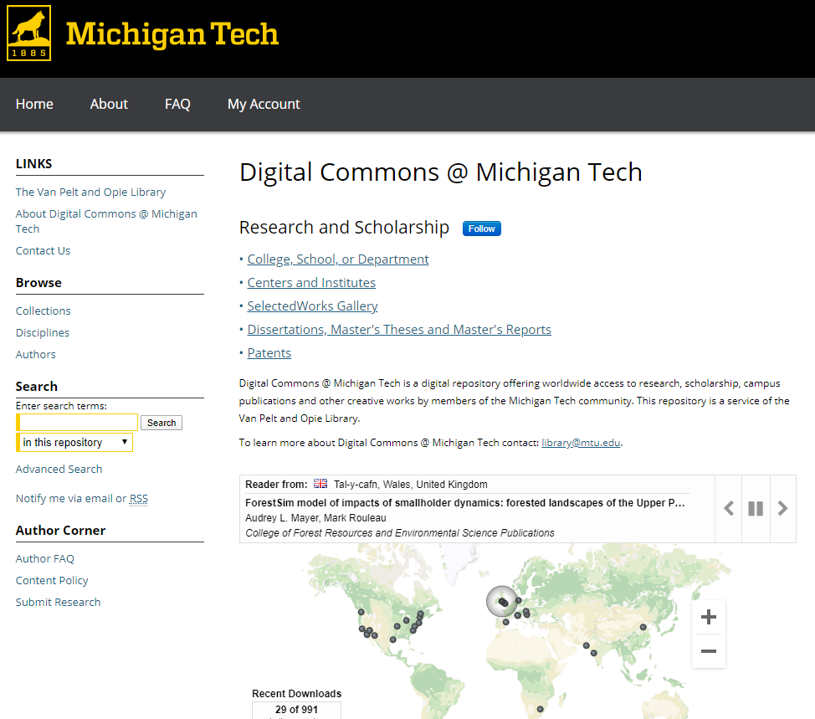
Data in Digital Commons @ Michigan Tech
Visit: digitalcommons.mtu.edu
Digital Commons @ Michigan Tech ≠
Digital Measures

Slide 25
Data in Digital Commons @ Michigan Tech
2 methods to make your data more accessible:
Link to where it’s available elsewhere
OR
Deposit your data files into the repository
Work with a librarian to determine structure and metadata
All file types accepted
Unlimited storage space (but uploads must be less than 20gb)
Usage stats
Shareable, unique, and persistent URLs
DOIs - coming soon!
Formal process - coming soon!

Slide 26
Data in Digital Commons @ Michigan Tech
2 methods to make your data more accessible:
Link to where it’s available elsewhere
Example: https://digitalcommons.mtu.edu/michigantech-p/533
OR
Deposit your data files into the repository
Example: https://digitalcommons.mtu.edu/physics-fp/12/ (single file)
Example: https://digitalcommons.mtu.edu/physics-fp/135/ (.zip)

Slide 27
Data Sharing and Preservation: No sharing
Funders do not expect researchers to share data that is confidential
Funders do not expect researchers to share data at “more than incremental cost”
You must justify not sharing in your DMP
State what data will not be shared and why
Notes:
If there is an anticipated cost to sharing and presevering data, write that into your grant

Slide 28
So what about costs?
Your DMP may include budget info:
information on costs of data preparation & documentation
hardware, software
personnel
repository fees
how costs will be paid
request funding
Notes:
from DMP Tool general purpose slides, February 2020

Slide 29
DMP Resources
DMPTool: https://dmptool.org/
Generic templates to create DMP for many funding agencies
Use your Michigan Tech username and password
RD Toolkit: https://sites.google.com/mtu.edu/rdtoolkit/home
Research Development Office (rd-l@mtu.edu)
Resources for all steps of the proposal process
ITHelp@mtu.edu
Help with data security, storage and management
Library@mtu.edu
Help locating mandates, requirements, tools and best practices
Data Management Planning guide: https://libguides.lib.mtu.edu/datamanagement
Notes:
Some researchers have found DMPTool too generic, too basic, but it is worth checking out.
RD Toolkit is growing, but has some sample DMPs from Tech researchers

Slide 30
DMPTool
A great source of:
Funder guidance
Public DMPs
Data management resources
Coming soon: Guidance developed specifically for the Michigan Tech community
Create an affiliated account to ensure access to help and resources
Notes:
from DMP Tool general purpose slides, February 2020

Slide 31
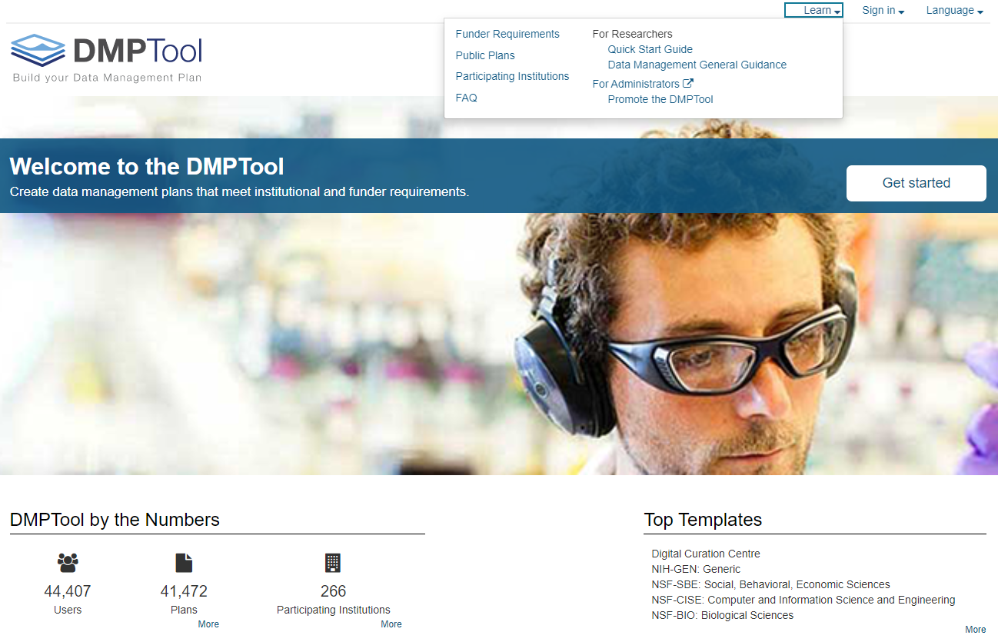
dmptool.org
Funder Guidance
Public Plans
Data Management Resources
Notes:
Some researchers have found DMPTool too generic, too basic, but it is worth checking out.
RD Toolkit is growing, but has some sample DMPs from Tech researchers

Slide 32
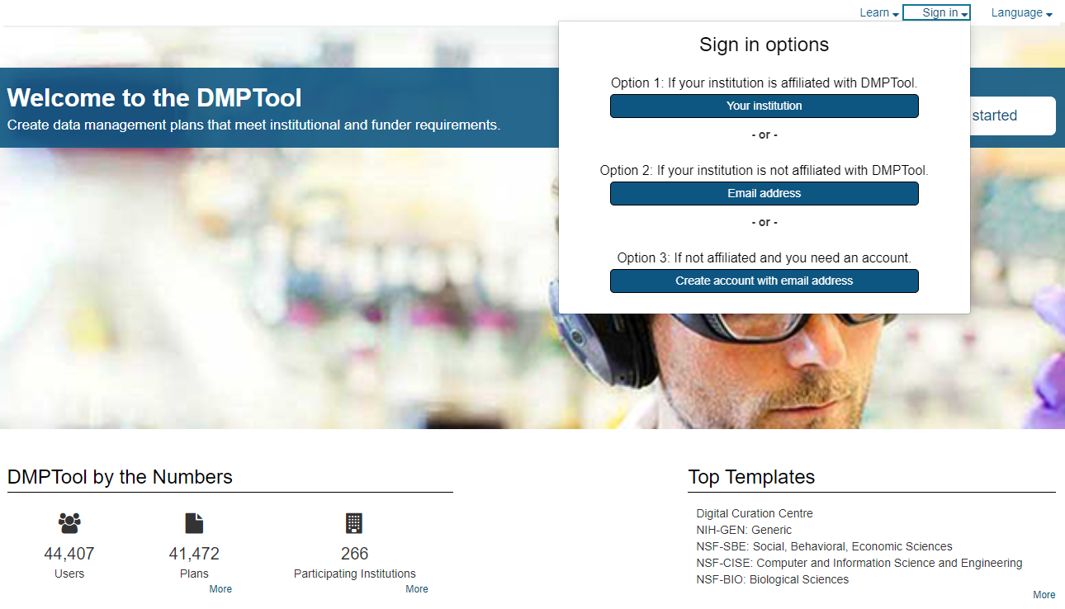
dmptool.org
Notes:
Some researchers have found DMPTool too generic, too basic, but it is worth checking out.
RD Toolkit is growing, but has some sample DMPs from Tech researchers

Slide 33
Setting up your DMPTool Account
Step 1:
Select Michigan Technological University
Notes:
Some researchers have found DMPTool too generic, too basic, but it is worth checking out.
RD Toolkit is growing, but has some sample DMPs from Tech researchers

Slide 34
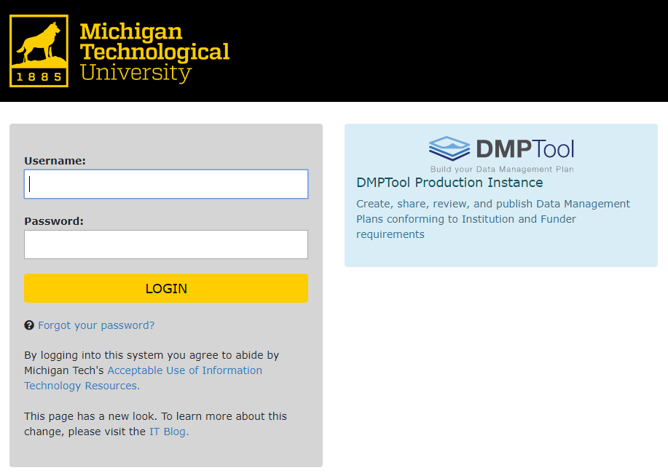
Setting up your DMPTool Account
Step 2:
Sign in using your Michigan Tech username and password
Notes:
Some researchers have found DMPTool too generic, too basic, but it is worth checking out.
RD Toolkit is growing, but has some sample DMPs from Tech researchers

Slide 35
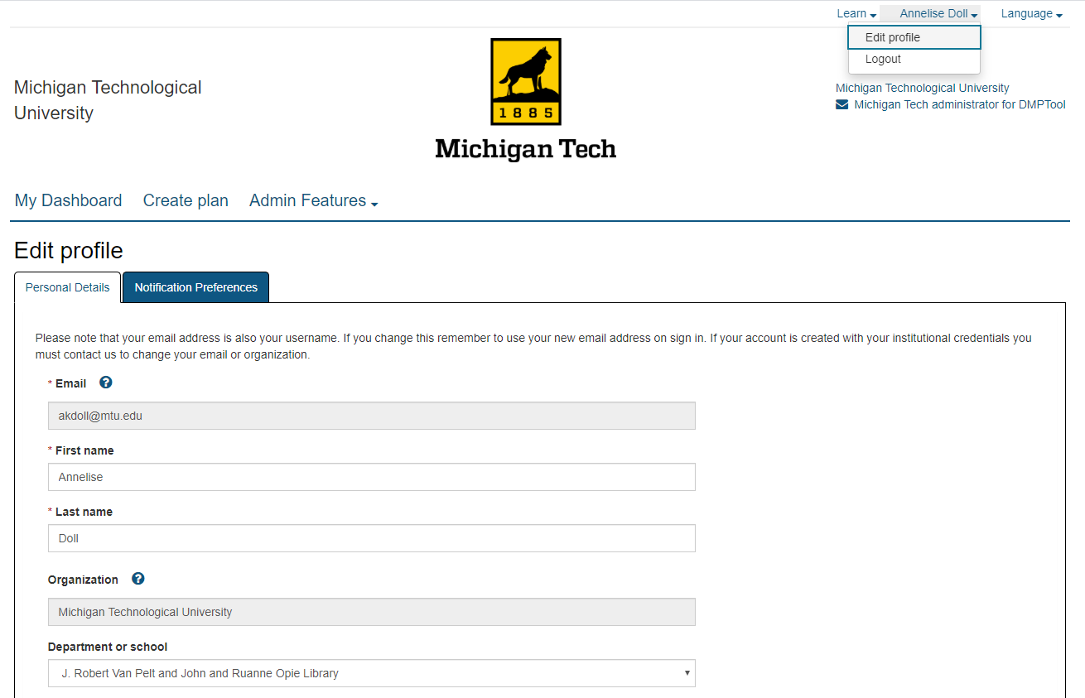
If you already have a DMPTool Account:
Select “Edit profile” from your account drop-down menu
Add “Michigan Technological University” to the Organization field
Select your unit from the drop-down menu under “Department or school”
Notes:
Some researchers have found DMPTool too generic, too basic, but it is worth checking out.
RD Toolkit is growing, but has some sample DMPs from Tech researchers

Slide 36
DMPs: Key to Success
A good DMP demonstrates comprehensiveness, thoughtfulness, and efficiencies of your project
Think of your DMP as a guide for your project data, clearly describing the who, what, when, where and how
Plan collaboratively if working collaboratively
Need help? Ask for help!

Slide 37
What questions do you have?
Thank you!
Annelise Doll
akdoll@mtu.edu

